Slide 1




Video Reflexive Ethnography as a research and healthcare improvement tool – methodology and application.
Dr Nina Fudge, QMUL
Dr Siobhan McHugh, University of Leeds
Dr Clair le Boutillier, KCL

Slide 2
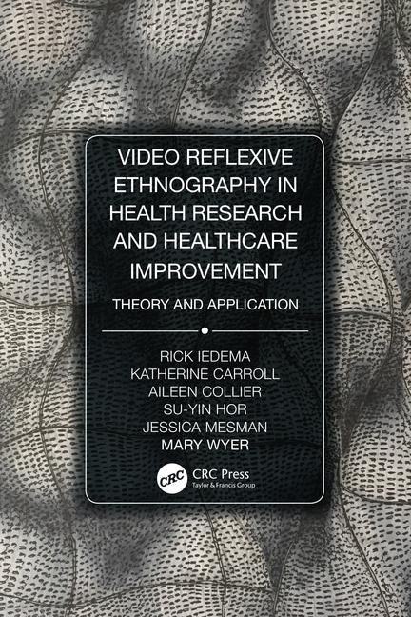
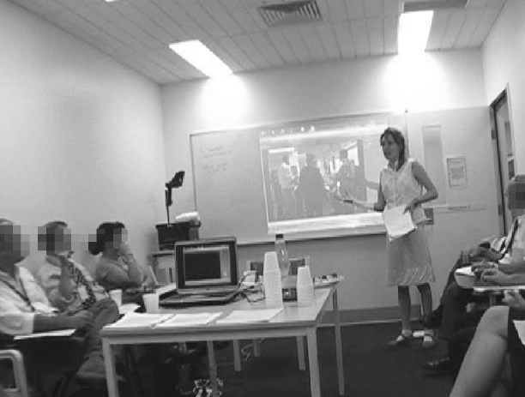
What is VRE?
Image from Karroll et al. Reshaping ICU Ward Round Practices Using Video-Reflexive Ethnography. Qualitative Health Research 2008; 8 (3).

Slide 3
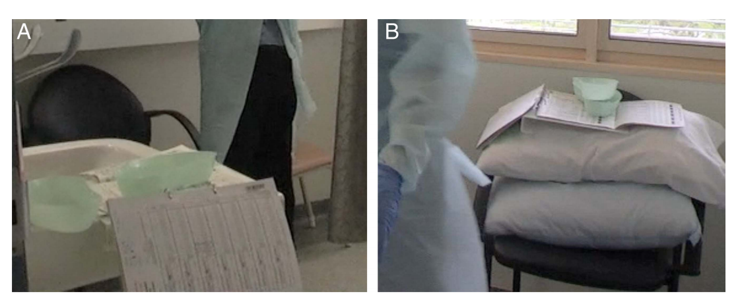
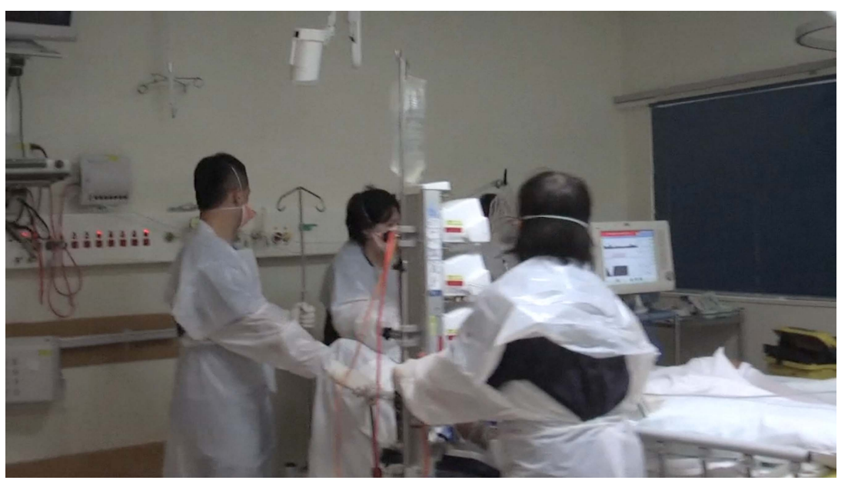
Why VRE?
Provides a very different view of work.
Insights gleaned from observing the ‘ordinary’
Notice things that have become ‘taken for granted’ or ‘hidden in plain sight’
Appreciate the complexity of work
Connect with practice in a new way
Images from Iedema et al. An innovative approach to
strengthening health professionals’ infection control and limiting hospital-acquired infection: video-reflexive ethnography. BMJ Innovations 2015

Slide 4

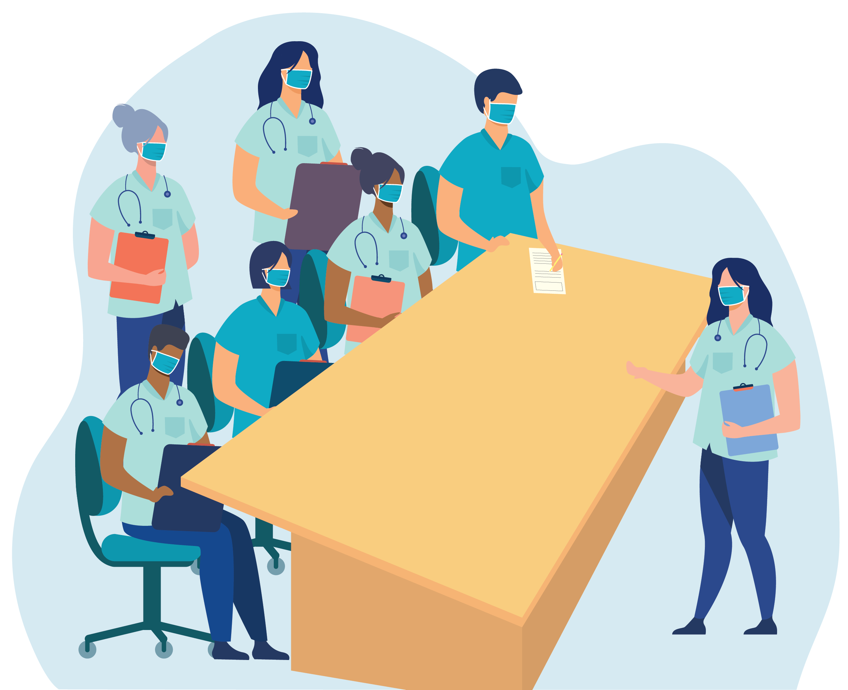


The steps in doing VRE
Understanding the field and building trust
Participant observation
In-depth interviews
Filming interactions
Researcher filmed
Participant filmed
Reflexive sessions
Feeding back discoveries / implementing change

Slide 5
VRE - guiding principles
Research participants
(zone of
maximal
complexity)
Exnovation
Collaboration
Reflexivity
Care

Slide 6
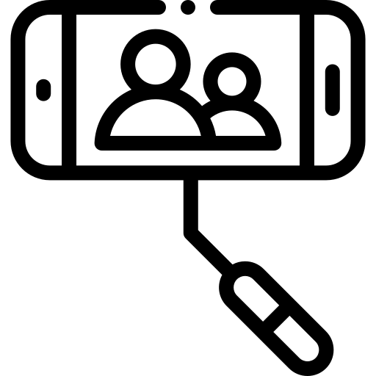


VRE as a potentiation technology
(Re)
discovery
Learning
Action
A tool, concept or method which can lead to the opening of possibilities

Slide 7
How do these approaches work?
Capturing life as it happens
Reflection on and learning about practice
Develop ideas for change
Witnessing practice they may have taken for granted
New ways of saying and seeing
What if…?
I’ve been thinking... could we…?

Slide 8
Finding out more about VRE

Slide 9



Professional practices of polypharmacy: a video-reflexive ethnography
Deborah Swinglehurst and Nina Fudge

Slide 10

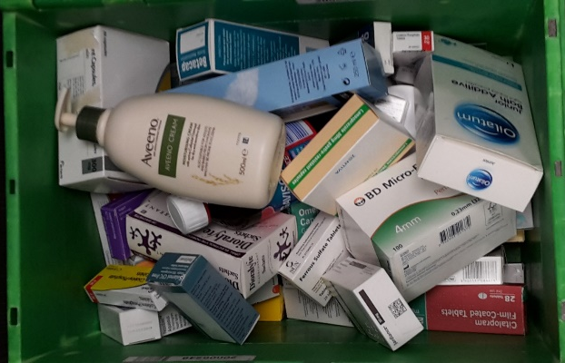
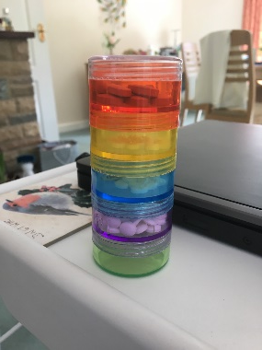
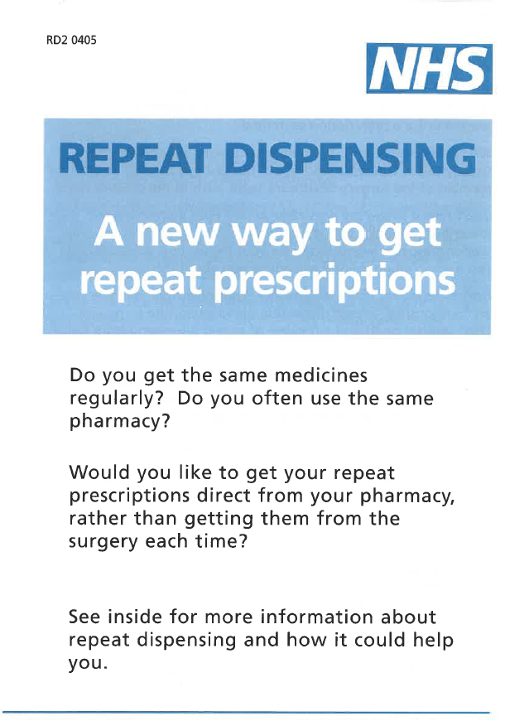
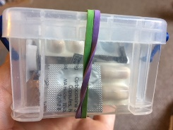
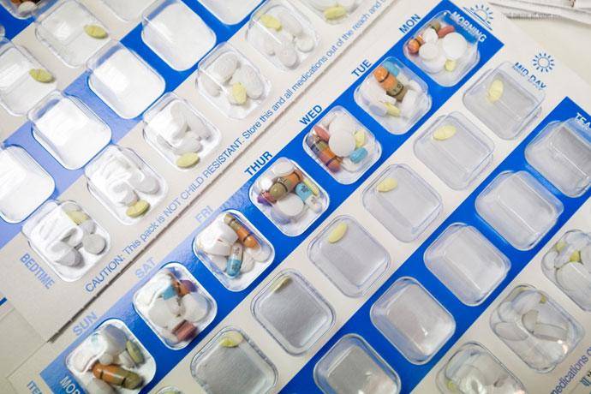
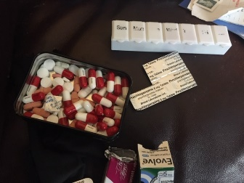

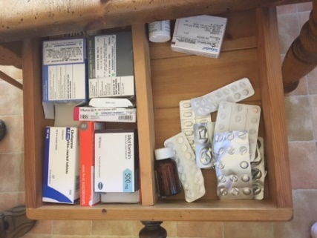

How do the practices of patients and their carers, healthcare professionals and care systems support ‘appropriate’ polypharmacy or challenge ‘inappropriate’ polypharmacy?
Patients’ homes
General Practice
Community pharmacy

Slide 11
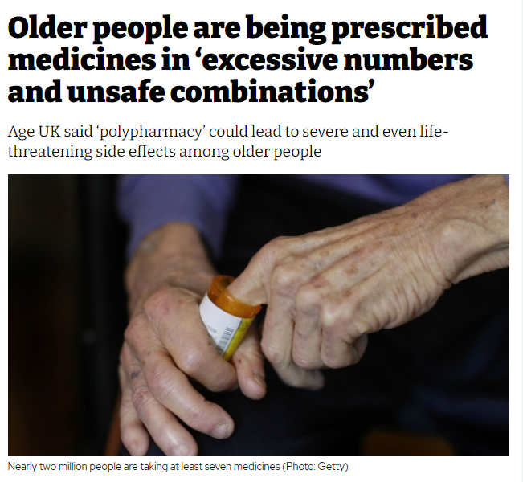
Polypharmacy
50% of all medicines prescribed for long-term conditions are not used.
Cost to the National Health Service £300m

Slide 12
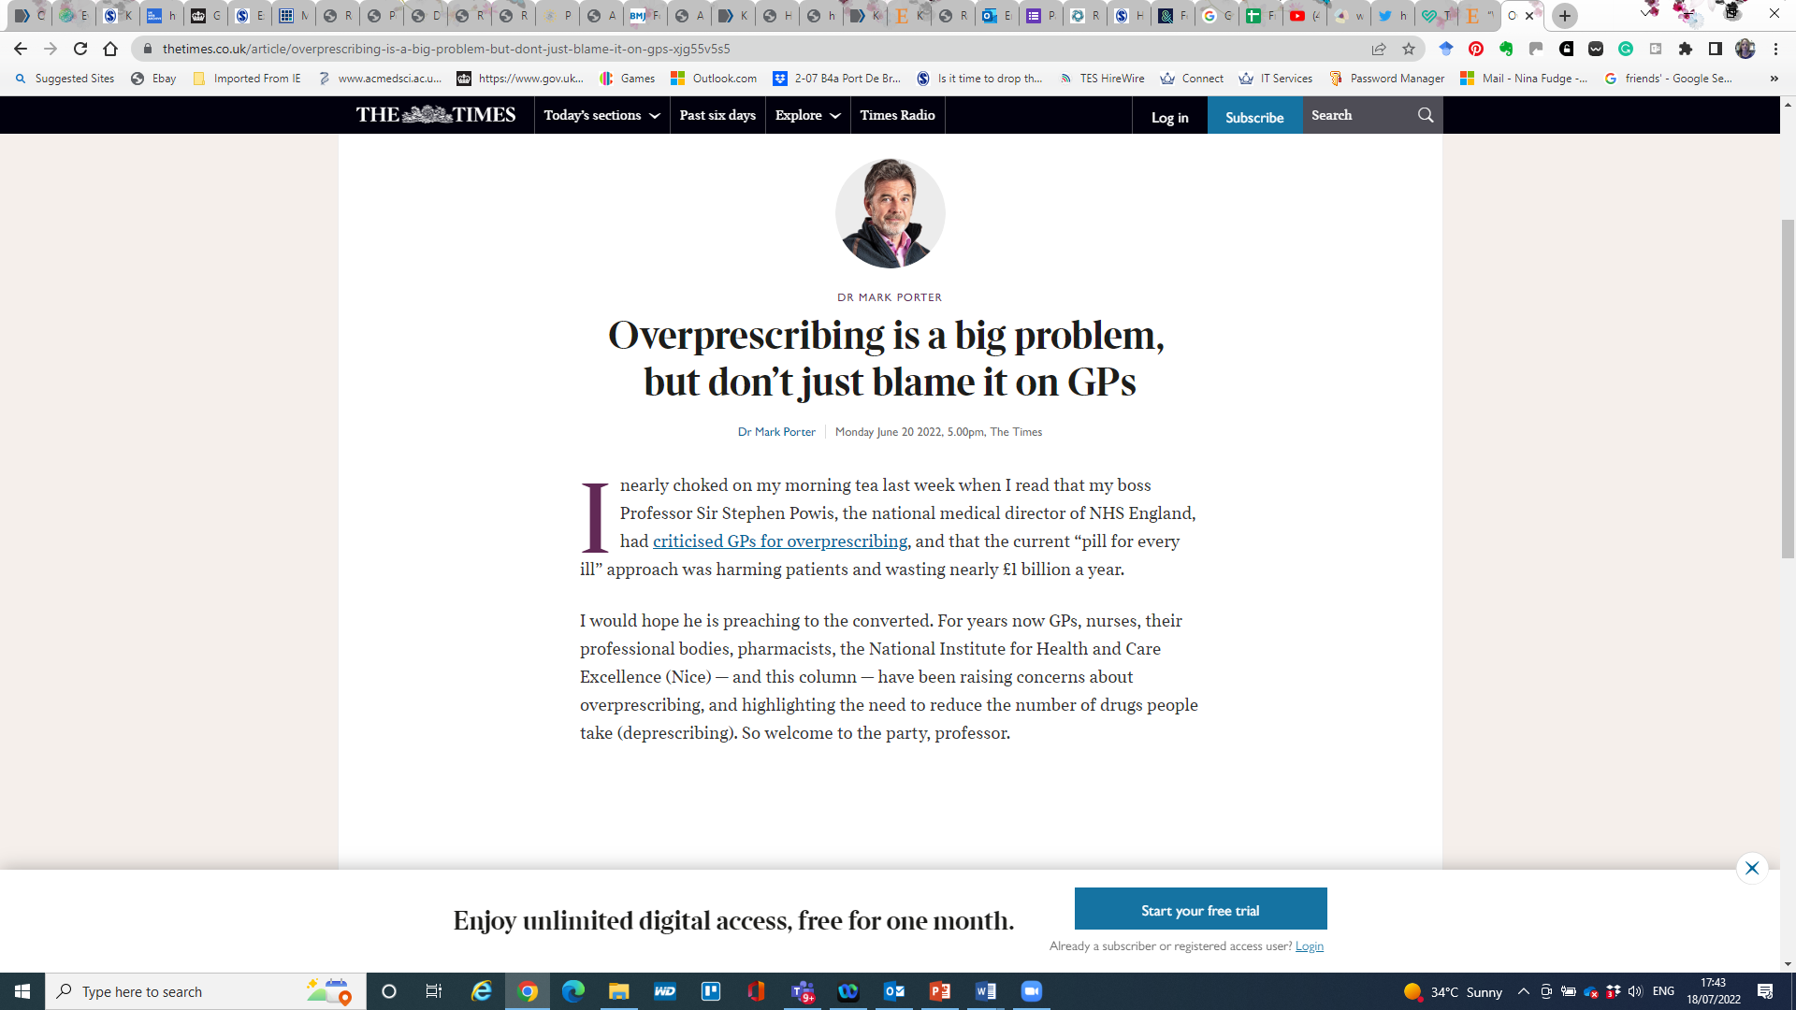
Polypharmacy as paradox
What do GPs do when faced with this ‘polypharmacy paradox’?
How do they make sense of their activities?

Slide 13
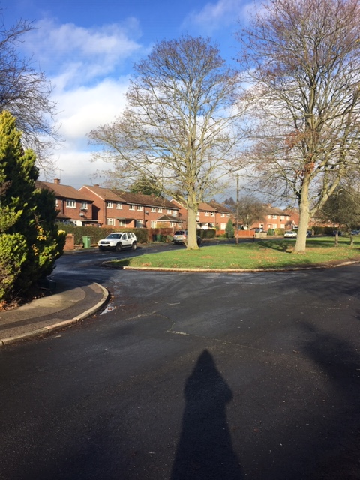
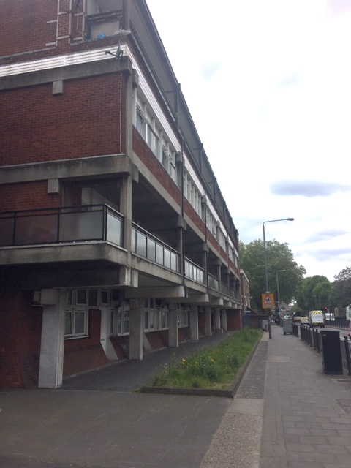
10 patients
Community pharmacy 1
Community pharmacy 2
GP
practice 1
14
patients
Community pharmacy 3
GP
practice 3
Community pharmacy 4
GP
practice 2
Notes:
Our ongoing research is taking place in two sites – one suburban, one urban - across 3 GP practices, 4 pharmacies and in patient’s homes.
The ethnographic approach of our research allows us to see the practices of polypharmacy in the home, GP surgeries and community pharmacies.
We are achieving this through ethnographic observation at these sites, narrative interviews with patients and professionals, cultural probe techniques and filming consultations and appointments between health care professionals and patients where medicines are discussed. These video clips are then used as prompts for reflection and discussion amongst professionals.

Slide 14
10 patients
Community pharmacy 1
Community pharmacy 2
GP
practice 1
14
patients
Community pharmacy 3
GP
practice 3
Community pharmacy 4
GP
practice 2
Notes:
Our ongoing research is taking place in two sites – one suburban, one urban - across 3 GP practices, 4 pharmacies and in patient’s homes.
The ethnographic approach of our research allows us to see the practices of polypharmacy in the home, GP surgeries and community pharmacies.
We are achieving this through ethnographic observation at these sites, narrative interviews with patients and professionals, cultural probe techniques and filming consultations and appointments between health care professionals and patients where medicines are discussed. These video clips are then used as prompts for reflection and discussion amongst professionals.

Slide 15
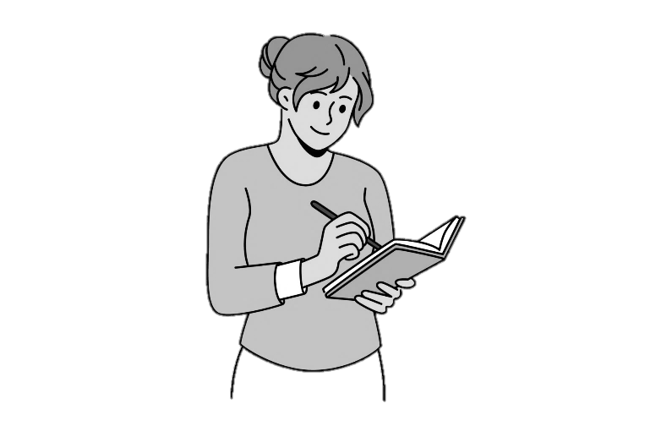
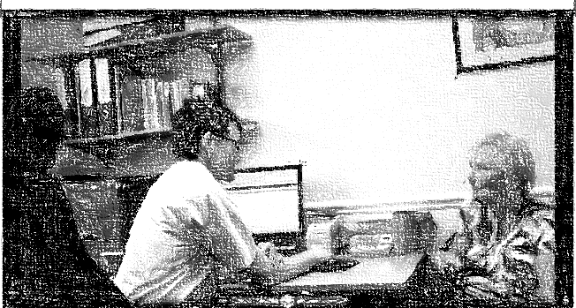
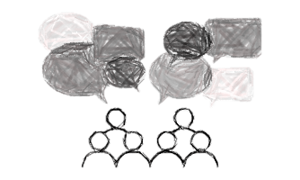

VRE methods in our project
Participant observation in three general practices
422 hours
Filmed 18 consultations
GP practice A n = 5
GP practice B n = 5
GP practice C n = 8
Selected short clips ‘critical moments’
7 reflective workshops
GP practice A n = 3
GP practice B n = 3
GP practice C n = 1

Slide 16
Research aims
illuminate how medication reviews are conducted in practice in the context of polypharmacy
elicit professional concerns about polypharmacy practices
harness the potential of VRE to provoke new transferable understandings relevant to the process of managing polypharmacy

Slide 17
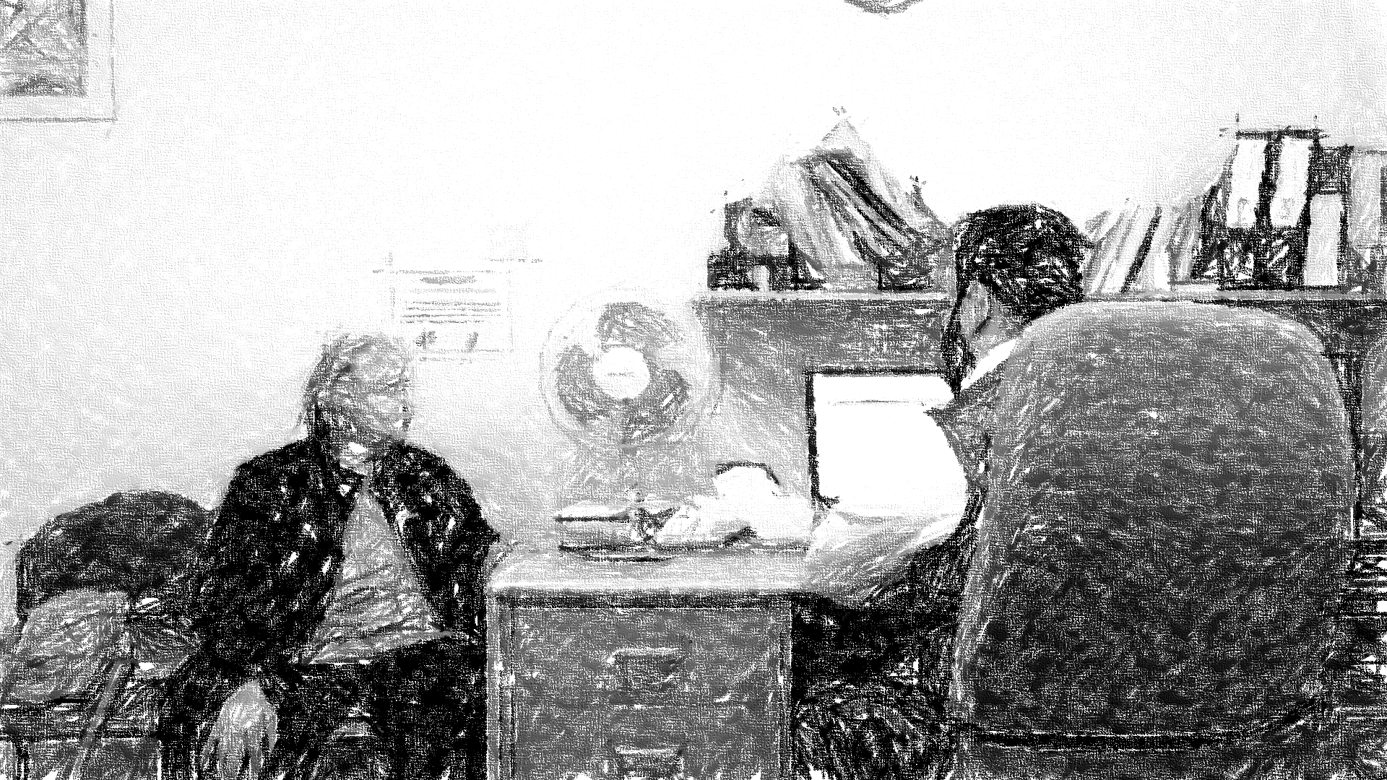
1. Appreciating complexity of their work
“People are trying to do like a super-complex bit of work within 10 to 15 minutes”
[GP7 Site C workshop 1]
“We’re fighting a losing battle sometimes. (…) A lot of our patients are equally complex and we are trying to do too much in our consultations” (loud murmurs of agreement)
[GP2 Site A workshop 1]
“It just made me realise how complex the whole polypharmacy is. There’s so many different factors, both for me and for the patients. And actually, I’m someone who likes to think systematically about things, and it’s very difficult to think systematically about something that is this complex… just an awareness of that is helpful.”
[GP1 Site B workshop 3].
“Just a medication review”

Slide 18
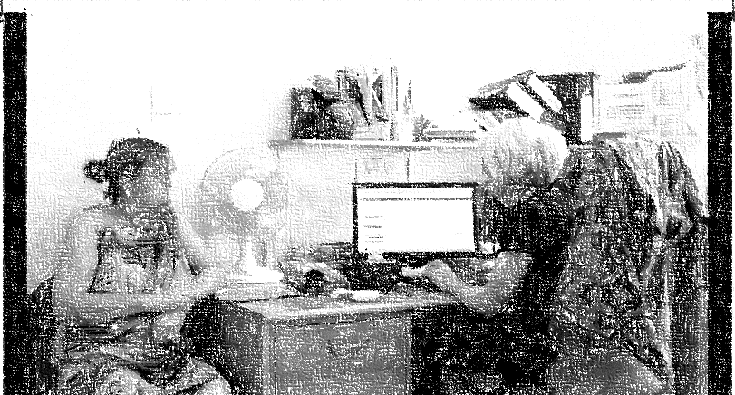
2. Organising the medication review
The computer as the organising tool
Patient’s medicines as the organising tool
“as they see something [a medicine] it kind of triggers something else: ‘yeah I might need some more of those, and can you…?’ So it’s just trying to organise those tasks”
[GP1 Site A workshop 1]

Slide 19

3. Changing and stopping medicines – who is responsible?
Upsetting the status quo
“It’s often an awful lot easier just to maintain medication than alter it”
Discomfort of stopping medicines prescribed by other clinicians
The GP looked at his computer, highlighted several drugs on the screen, then turned to the patient:
“From the point of view, I think, of stopping anything today, there’s probably nothing I can stop in terms of your heart tablets”

Slide 20
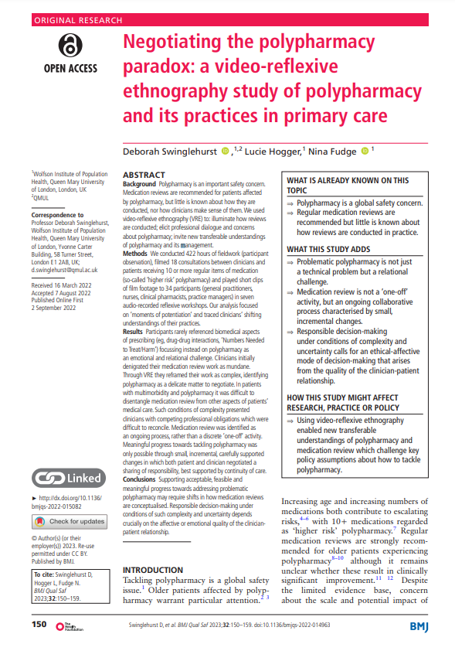
Summary
VRE enabled general practice staff to shift their thinking and reframe their practice:
  Medication reviews seen as complex work requiring ongoing incremental steps (Mol’s work on tinkering)
  Ways to organise and structure the medication review
  GP colleagues and patients identified as partners in stopping medicines
Future research: VRE of NHS England primary care contract for delivery of Structured Medication Reviews by pharmacists as well as GPs.

Slide 21
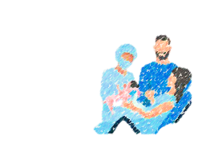


Evaluating video reflexive ethnography as a healthcare improvement tool in acute maternity services
Dr Siobhan McHugh
Senior Researcher | School of Healthcare, University of Leeds
Supervisors: Professor Rebecca Lawton, Professor Jane O’Hara, Dr Laura Sheard, Mr Dileep Wijeratne

Slide 22

Why the MDT handover?
Transfer of professional responsibility & accountability;
Gathering of otherwise transient teams – shared awareness;
Essential for the successful function of teams working in complex systems.
Poor handover is a major contributing factor in safety incidents and harm;
Impact on staff well-being, self-confidence and job satisfaction.
“The single biggest problem with communication is the illusion that it has taken place.”
George Bernard Shaw
McHugh, S. K., Lawton, R., O'Hara, J. K., & Sheard, L. (2020). Does team reflexivity impact teamwork and communication in interprofessional hospital-based healthcare teams? A systematic review and narrative synthesis. BMJ Quality & Safety, 29(8), 672-683.

Slide 23
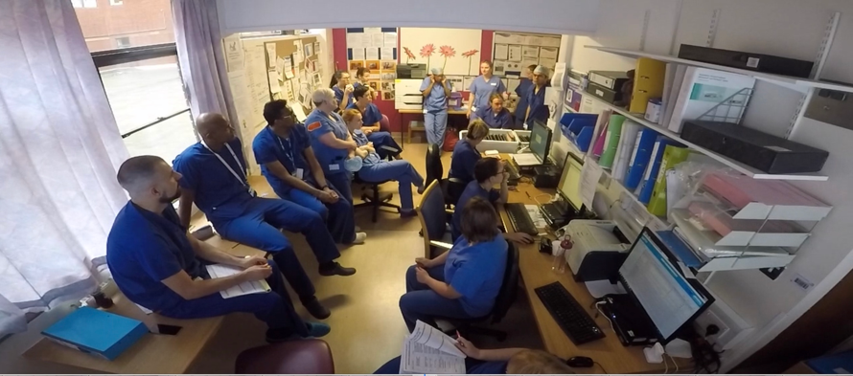
The handover before…

Slide 24
Video potentiates learning by acting as ‘self irritant’.
Prompts ‘liminalisation’ – learning by stepping away from what is taken-as-given.
Collective articulation of the unseen.
McHugh, S., Sheard, L., O’Hara, J., & Lawton, R. (2022). The feasibility and acceptability of implementing video reflexive ethnography (VRE) as an improvement tool in acute maternity services. BMC Health Services Research, 22(1), 1-13.

Slide 25
What was discovered?
Environment is poor
Information transfer
Interruptions
Confidentiality
Silos
One way
Quality
Space and distancing
Inconsistency
MDT

Slide 26
What were the solutions?
Solutions
Restructure handover
Environment
Consider all staff – not just those attending

Slide 27
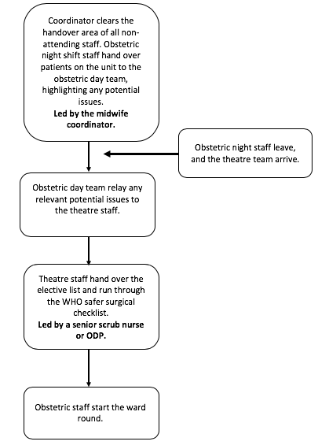
Obstetric night and day team, and theatre team, congregate in reception area of delivery suite.
Theatre team present the elective list for the day and work through surgical checklist.
Led by consultant anaesthetist.
Obstetric night team hand over to the day team.
Discussion of any potential problematic cases with the theatre team.
Led by midwife coordinator and night SHO.
Obstetric staff leave to start the ward round.
Theatre staff leave to prep for the first elective.
Night staff leave.

Slide 28
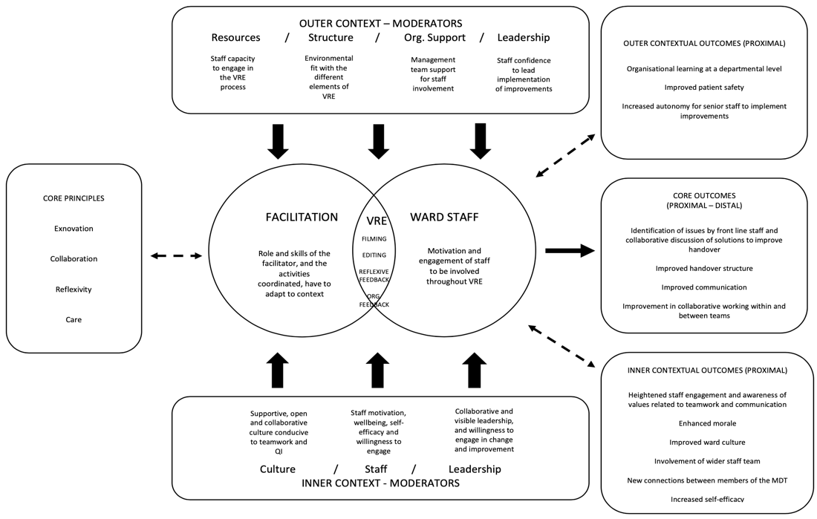
What does this mean for maternity safety?

Slide 29
At an organisational level VRE can prompt learning about work as done versus work as imagined (i.e. policy, SoP, procedure).
Learning can directly influence policy & procedure.
VRE prompted individual and group learning; both procedural and ‘cultural’.
Opportunity to learn about complexity of the everyday.

Slide 30



S.McHugh@leeds.ac.uk
@skmc84

Slide 31

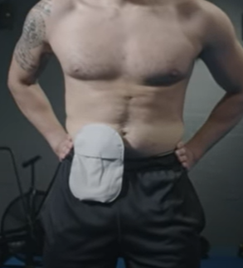


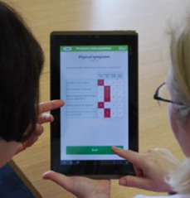




Improving digital personalised care and support planning for people with colorectal cancer
Clair Le Boutillier THIS Institute Research Fellow

Slide 32

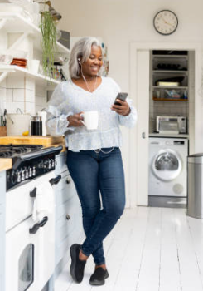


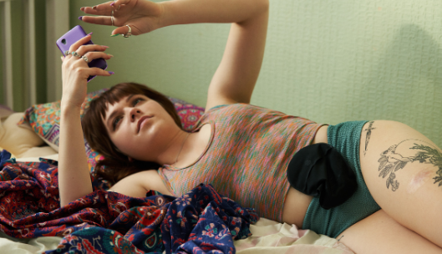




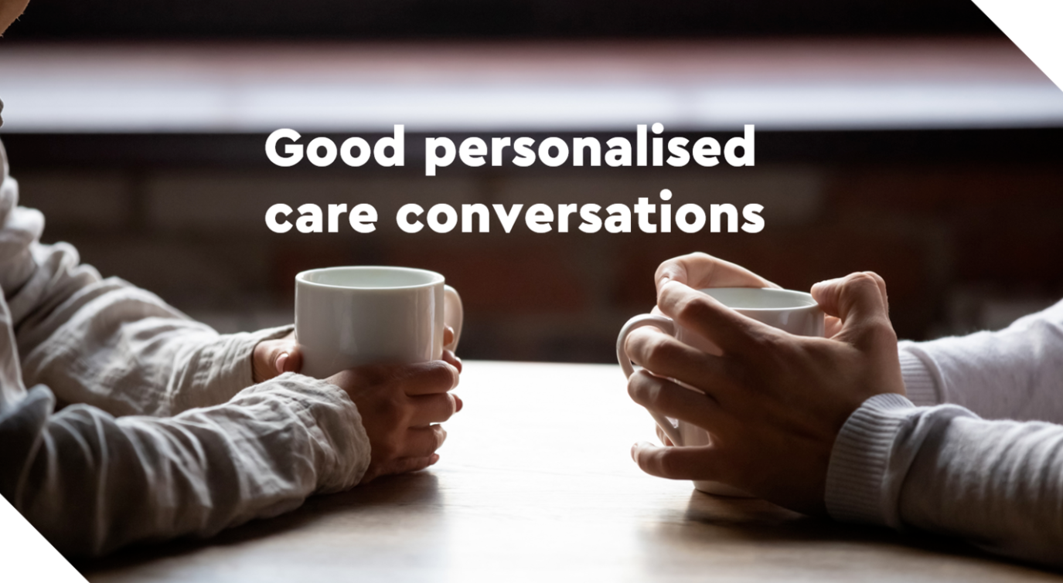
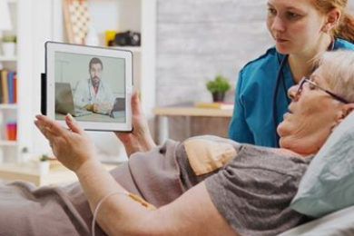

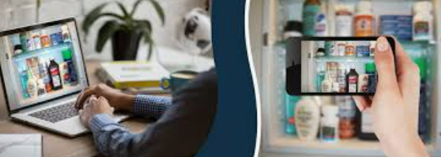
Digital Personalised Care and Support Planning: The eHNA
Identifying what good looks like and co-designing improvements

Slide 33

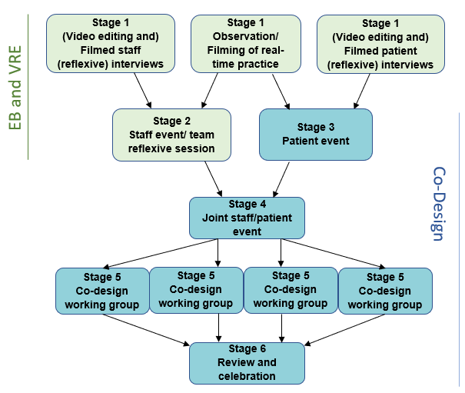
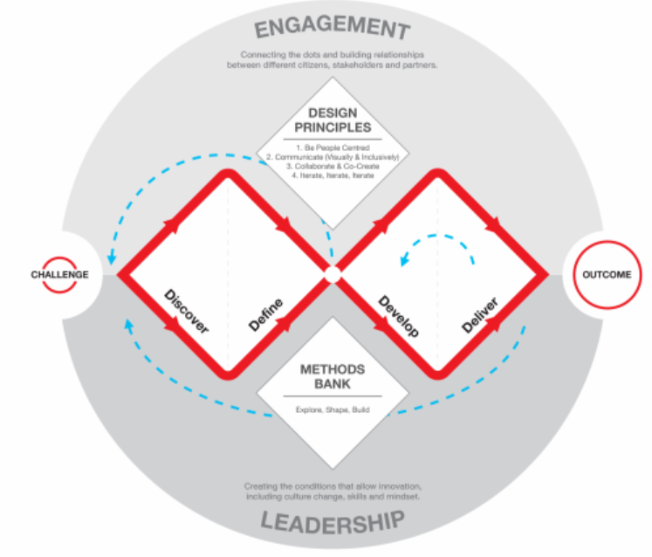
A multi-modal approach:
Double Diamond, EBCD and VRE
EB
VRE
CD

Slide 34
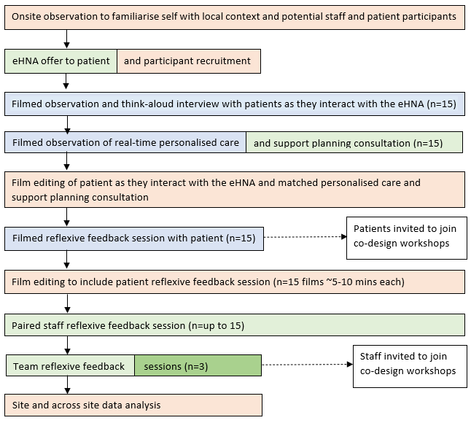



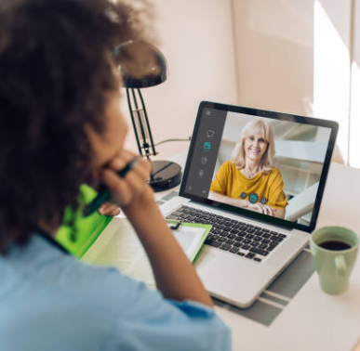



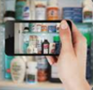
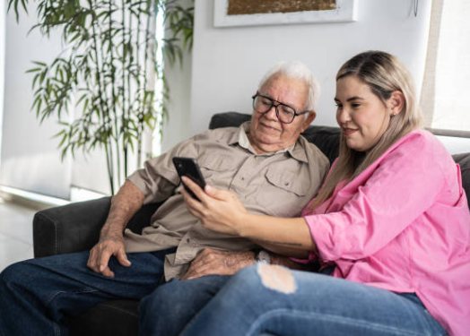
Video-Reflexive Ethnography:
Exploration phase to gather experience data & form insights
Video recording at three time points:
1. As patients interact with the eHNA tool
2. The care planning consultation with patients and
clinicians
3. Patient reflexive sessions

Slide 35
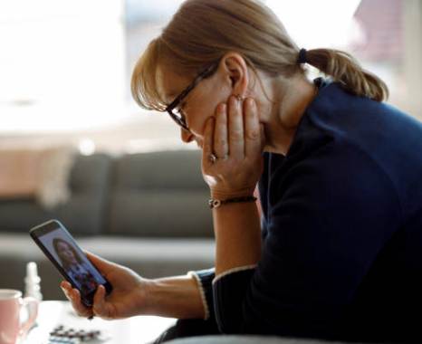





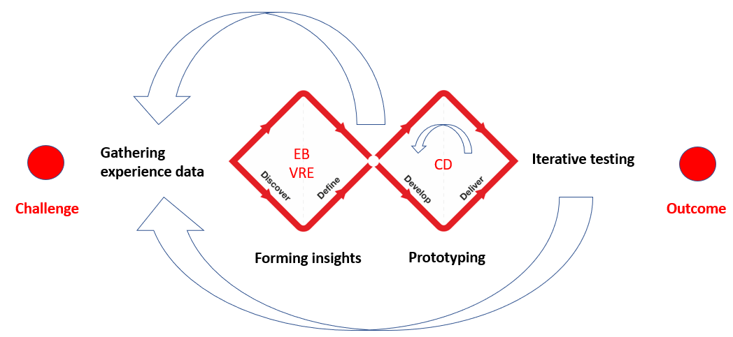


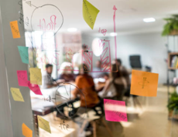


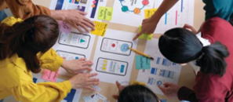
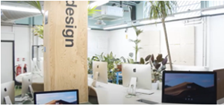
Benefits of blending Double Diamond, VRE and EBCD

Slide 36

Any Questions?
clair.le_Boutillier@kcl.ac.uk
@CLe_Boutillier
Thank you!

