Slide 1


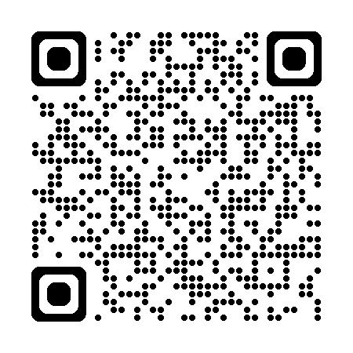

Knowledge mobilisation is about getting the right information to the right people in the right format at the right time - by actively collaborating
A canopy of activities helps mobilise knowledge effectively
Engagement and exploring needs
Potential users of research knowledge are identified and their priorities properly understood. Networks of people are built to share ideas, good practice, recent research etc, and Communities of Practice are developed.
Coproduction
People with lived experience and end users direct and inform all parts of the work throughout the research life cycle.
Synthesis
Evidence is appraised and consolidated into a useable package of information for others.
Sharing findings
Ways to get research findings to those who could use them in the right format and timeframe are developed and delivered.
Training and capacity building
Research findings and support for KM capacity-building are packaged up into training sessions, events, online resources etc.
Implementation
Approaches to applying research and innovation to change practice are identified and delivered.
Influencing
Decision-makers are identified and engaged. Windows of opportunity for influencing change are optimised.
And don’t forget to evaluate throughout!
Adopting a strategic approach, by first clarifying the impact you want, can help you prioritise which KM activities to use with particular groups

