Slide 1
NIHR ARC Wessex
Content Analysis of Interviews and Surveys
Method and Application
Dr Sarah Fearn, Senior Research Fellow
Veena Agarwal, Senior Research Physiotherapist

Slide 2
Content Analysis - Uses
Family of approaches
“a systematic and objective means to make valid inferences from verbal, visual, or written data in order to describe and quantify specific phenomena” (Downe-Wambolt 1992)
(but not always -
Sarah – interviews and surveys
Veena - surveys
Also, other texts, images, audio, videos

Slide 3
Content Analysis - Methodology
Data collection
Familiarisation of the data
Coding process
(inductive / deductive)
Count
Data collection – collected or sampled
Familiarisation – immersion in the data; understand the ‘whole’
Coding
  Inductive – ‘conventional’, ‘qualitative’
  Deductive – ‘directed’, ‘summative’, ‘quantitative’
  Level of analysis: word, word sense, phrase, sentence, themes
  Explicit or inferred communication (manifest or latent)
Count
  No count, conceptual, relational analysis

Slide 4

10 Steps to Content Analysis Nirvana
Fatigue in Parkinson’s Disease (PD)
Part 1: Survey assessing features of fatigue in PD
Description, triggers, impact and management
Mixed methods
Context to quantitative data
For e.g. Do you feel fatigued? Yes/No (% data)
How would you describe it? (weariness, exhausted, mentally tired, heaviness)

Slide 5
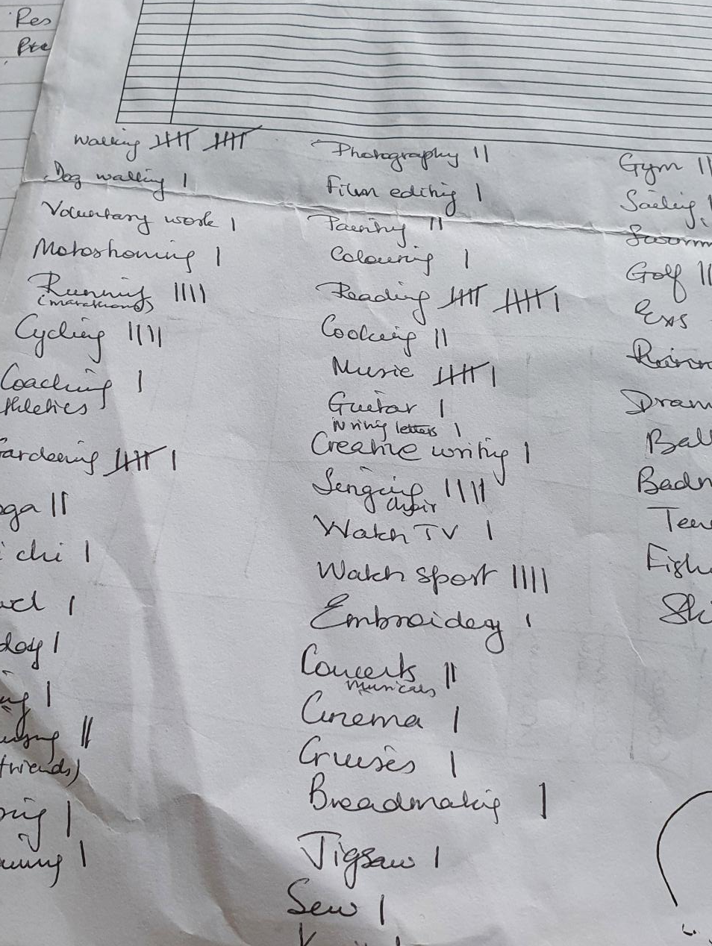
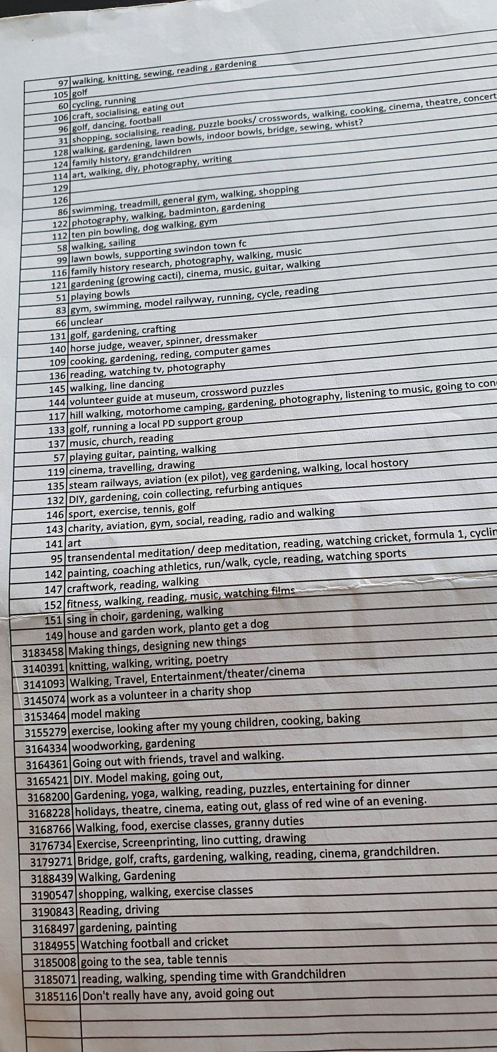
Working Example
How does Fatigue impact your work?
Step 1:
Familiarise yourself to data
(Open-ended question,
Responses: words and phrases)
Step 2:
Collate similar answers + Generate Frequency

Slide 6
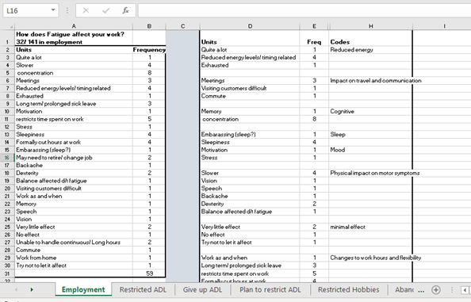
Step 3: Re-enter data as ‘Units’ and ‘Frequency’
Step 4: Start grouping to generate Codes
ARE WE THERE YET?

Slide 7
Step 5: Finalise Coding Frame
It may feel trivial but tighten your description for each code. A lay person should be able to code the data same as you #reproducibleresearch
No. | Code | Description (terms indicative of..)
1 | Work pattern affected | inability to do usual/ rostered hours, sick leave, changes required to hours worked, required to work flexible hours, retirement
2 | Impact on physical symptoms | Motor symptoms of PD and other physical symptoms; e.g. being slower, backache
3 | cognitive | loss of focus, concentration, inability to retain information
4 | Reduced energy | overall and significant loss of energy level, feeling exhausted.
5 | Impact on travel | commute to, from and during work
6 | Impact on communication | meetings, requires interaction
7 | Sleep | dowsiness and impact on sleep, impact on work due to poor sleep
8 | Mood | low mood and motivation, and stress
9 | Minimal effect | fatigue not having low/ minimal impact/ trying not to let fatigue impact work

Slide 8
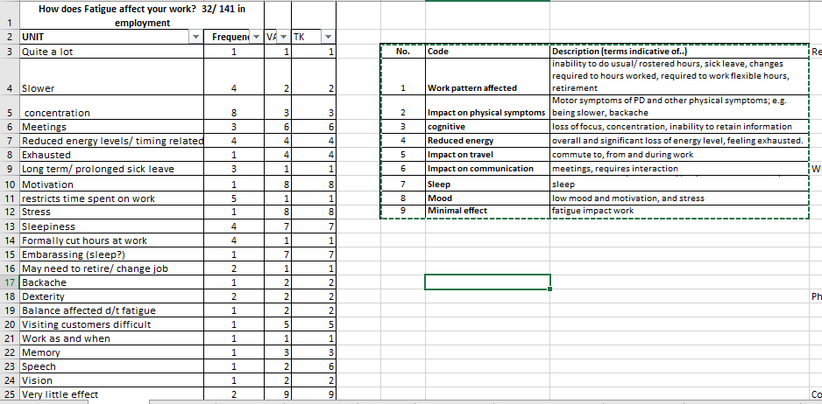
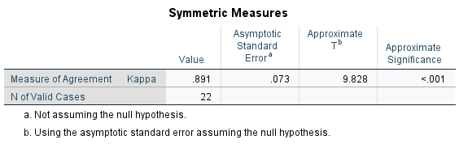
STEP 6: Code your data
STEP 7: Blinded rater coding
(can do first 20, etc)
STEP 8: Inter-rater reliability
Kappa score: 0.8-1
SPSS: Analyse> Descriptives> Crosstabs>Statistics> Kappa

Slide 9
Category | Sub-category | Frequency | % (n)
Energy levels and work pattern | Exhaustion | 5 | 40.7% (24)
 | Working Reduced hours | 9
 | Unable to handle hours | 3
 | Flexible working (as and when; work from home) | 2
 | Long-term sick | 3
 | Considering retirement/ change job | 2
Mood and focus | Concentration | 8 | 27.1% (16)
 | Memory | 1
 | Motivation | 1
 | Stress | 1
 | Sleepiness | 5
Travel and communication | Visiting customers difficult | 1 | 8.5% (5)
 | Commute | 1
 | Meetings | 3
Physical | Slower | 4 | 20.3% (10)
 | Backache | 1
 | Dexterity | 2
 | Balance affected d/t fatigue | 1
 | Speech | 1
 | Vision | 1
Minimal Effect | Very little effect | 2 | 6.7% (4)
 | No effect | 1
 | Try not to let it affect | 1
STEP 9: Look for themes, form groups or categories that answer your question
i.e. inductive process
(use filters to collate codes)
STEP 10: Total and calculate % for each theme/ category

Slide 10
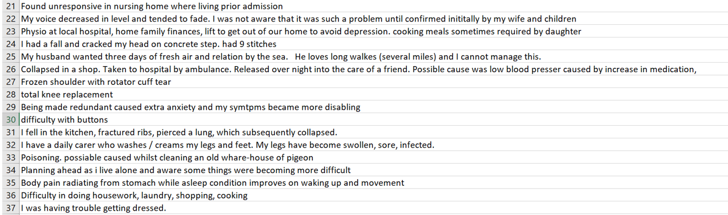
Content Analysis – Application in free text survey data
Neuro LTC
Please think about the last time that you required extra care. What happened that led to you requiring
extra care?

Slide 11
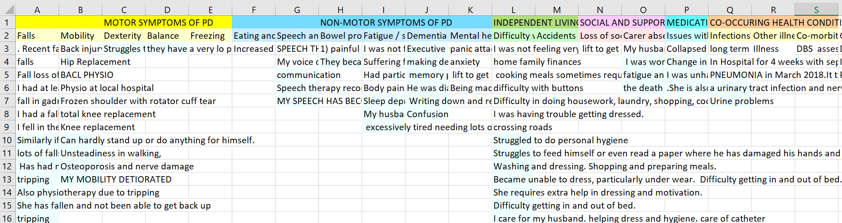
Content Analysis – Application in free text survey data
Neuro LTC
Please think about the last time that you required extra care. What happened that led to you requiring
extra care?
Iterative coding process – researchers x 2, clinician (CI), physiotherapist (PD specialism),
respondent validation

Slide 12
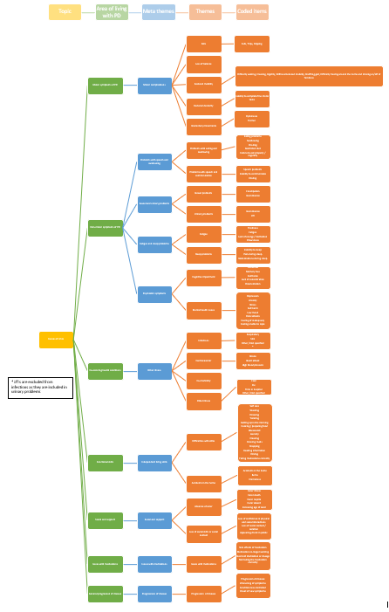

Slide 13
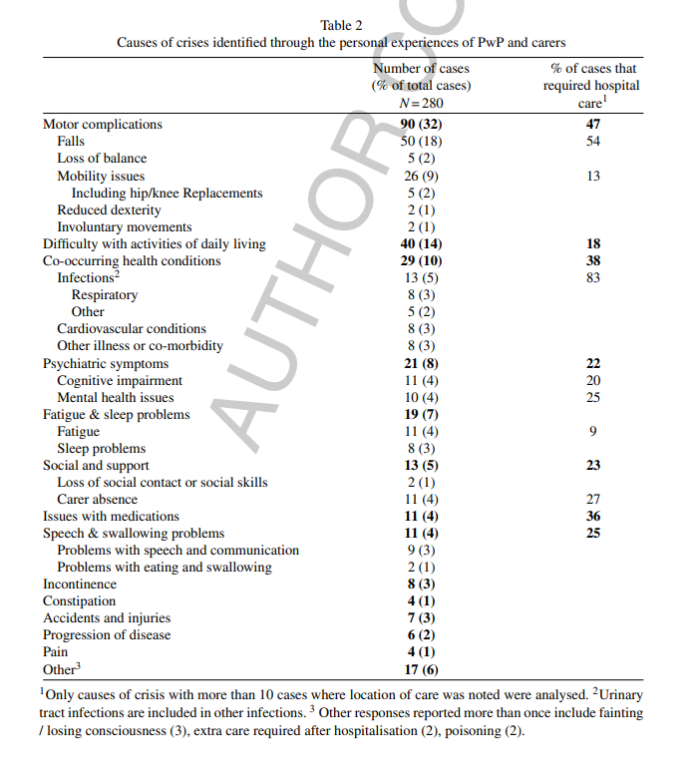
Neuro LTC
Fearn et al. ‘The Causes and Impact of Crisis for People with Parkinson’s Disease: A Patient and Carer Perspective’. Oct2021 : 1935 – 1945.
https://pubmed.ncbi.nlm.nih.gov/34250952/
Email S.Fearn@soton.ac.uk

Slide 14
Content Analysis – Application in interviews
Neuro Digital: Outpatient Perspectives
What do you value in your outpatient appointment?
Same open question asked to all participants
Smaller n = not able to do as detailed statistical analysis
Able to compare and also do some relational analysis
  People with MS mentioned “reassurance that symptoms are real” more than people with other neurological conditions
  Category of reassurance that symptoms are real mentioned close to mental health, cognitive and fatigue symptoms.

Slide 15
Content Analysis – Advantages and Challenges
Flexible
Content sensitive
Suitable for large volumes of data
No one way of doing it – what variation best for your data?
Justify your method
Subjective interpretations
Time consuming
[Qualitative content analysis – no counting – Elo 2008]

Slide 16
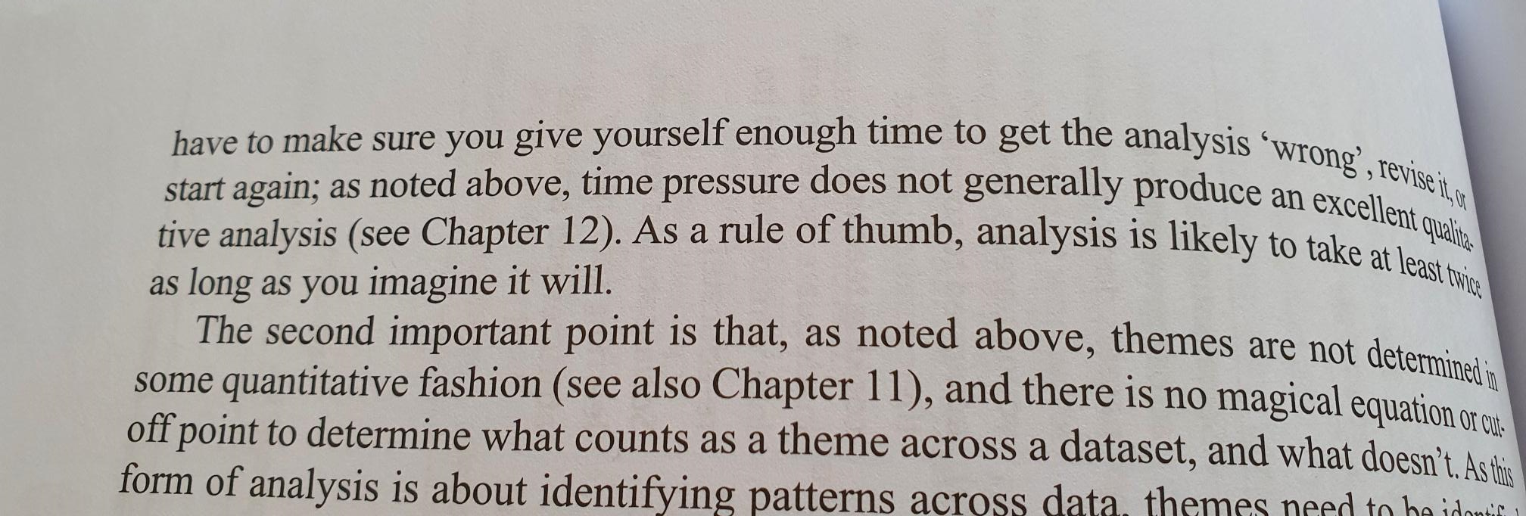
-Braun and Clarke, Successful Qualitative Research, Chapter 9: Familiarisation and data coding

Slide 17
Useful papers
Stemler, Steve (2001). An overview of content analysis. Practical Assessment, Research & Evaluation, 7(17). Available online: http://PAREonline.net/getvn.asp?v=7&n=17.
Hsieh, H.F. and Shannon, S.E., 2005. Three approaches to qualitative content analysis. Qualitative health research, 15(9), pp.1277-1288.
Elo S. and Kynga”.,2008 The qualitative content analysis process. Journal of Advanced Nursing 62(1), 107–115
doi: 10.1111/j.1365-2648.2007.04569.
Erlingsson, C. and Brysiewicz, P., 2017. A hands-on guide to doing content analysis. African journal of emergency medicine, 7(3), pp.93-99.
Sjölin, H., Lindström, V., Hult, H., Ringsted, C. and Kurland, L., 2015. What an ambulance nurse needs to know: a content analysis of curricula in the specialist nursing programme in prehospital emergency care. International emergency nursing, 23(2), pp.127-132.

Slide 18
Veena Vaa1v15@soton.ac.uk
@veena1818
Sarah S.Fearn@soton.ac.uk

