Slide 1
Using netnography as a methodological approach to explore virtual funding committee practice in the allocation of research funding
Amanda Blatch-Jones and Katie Meadmore

Slide 2



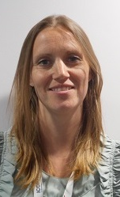


The RoR team

Slide 3
Research on Research – What is it?
‘Research on Research’ as a discipline is not new
Terms used to define RoR include meta-research and science of science
The discipline is growing and becoming increasingly relevant to the research and funder community
Study of research systems to provide scientific evidence for improving and strengthening the end-to-end research process
Seeks to understand and improve research systems so that the benefits that come from the investment made in research are transparent and evidence-based

Slide 4
NIHR Research on Research
The National Institute for Health and Care Research (NIHR), Research on Research is about the study of research processes and practices to support the continuous improvement of research management
RoR identifies and evaluates current process and potential improvements to these processes, in order to provide evidence-based recommendations for research management. All aimed at ensuring that research is robust, of high quality and credible to enhance the research management practices across the research community
To promote transparency and openness to inform recommendations beyond NIHR (generalisability to other funders)

Slide 5
Stage 1
Stage 1
Bridging study exploring necessary and unnecessary effort in obtaining funding and fulfilling research monitoring requirements
Scoping and exploratory exercise (feasibility of data and sources)
Survey of funders (decision-making processes for grant fund allocation)
Realist synthesis (decision-making approaches to research grants funding allocation)
Rapid scoping review (post-award management of UK health research)
THEME 1
Peer Review and Decision Making (PRDM)
Post-Award Management of Funded Research (PAM)
Secondary data analysis (Understanding expectations of the peer review process)
NIHR Evaluation, Trials and Studies Coordinating Centre
Research on Research Programme
THEME 2
Qualitative analysis of feedback to applicants
Qualitative analysis of the differences between contracts and grants
(funders perspective)
Netnographic study of funding committees (Qualitative study of funding practices)
Stage 2
Stage 2
eDelphi to identify alternative approaches
Describing current practice
+
Identifying future possibilities
Feasibility study of an alternative approach

Slide 6
Understanding funding committee practice
There is limited research investigating virtual funding committee processes, the role of members and their social interactions.
Netnography is a type of ethnography and is often termed digital anthropology. It shares
Common methodological connections such as views of the world, how to study the world and studying what is important within it
Common positions and practices such as human experience and cultural understanding, exploring social systems of shared meaning, informed by the researcher and participants

Slide 7
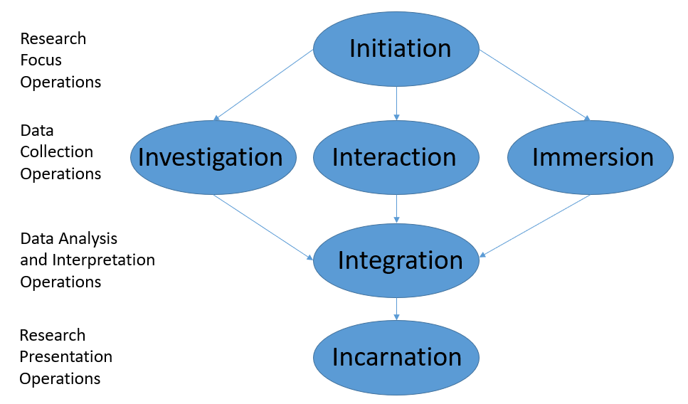
Netnography
Online ethnography is a generic category.
Netnography takes the approach of studying social media using a cultural lens.
Netnography has procedural guidelines. These are unique to this form of methodological approach.
Each operation has a number of guiding steps and principles

Slide 8
Netnography
Traditional ethnographic terms and concepts | Netnographic terms and concepts
Ethnography Field or Field site Fieldnotes Participation Observation Participant observation Interpretation | Netnography Data site Immersion journal Engagement Data operations Engaged data operations Integration

Slide 9
Netnography
Netnographic studies focus on social dynamics within technological contexts to understand online communicative acts and interactions using a cultural approach.
Following and using the principles of netnography
Explore
Reflect
Investigate

Slide 10
Netnography
Using netnography as a research methodology we proposed to explore:
virtual funding committee practices to understand how members participate (e.g. implicit and explicit social interactions),
insight into using online forms of communications (e.g. cultural changes),
and the benefits, challenges and barriers to using online platforms (e.g. to explore future considerations).

Slide 11
Netnography – Research Questions
How do virtual funding committee meetings provide an alternative approach for the recommended allocation of research funding?
Is there any impact of virtual funding committee meetings on the decision-making recommendations for research funding?
What are the key components/considerations of running and taking part in a virtual funding committee meeting and do they affect members’ experience?
How has the use of virtual online technology affected the social identity aspects of funding committee meetings?
Are there behavioural, attitude and relationship considerations (and constraints) when conducting virtual funding committee meetings?

Slide 12
Early insight and expectations
Survey data analysed (responses obtained and analysed n=50)
Observational data being analysed (six NIHR programmes, using nine committee meetings)
Interview data being analysed (n=18 with committee members and 12 with NIHR staff)
In parallel, all qualitative material (including text data from the virtual observations) will be analysed using an inductive approach. This will be further complemented with the survey material and documents from the committee meetings (mixed methods).
(following the guiding principles of netnography by Kozinets)

Slide 13
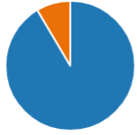
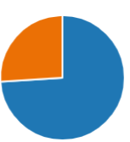
Early insight and expectations
Do you see any potential opportunities and benefits to using virtual online platforms?
Do you feel you can achieve the same outcome through virtual committees compared to face-to-face?
YES
(91%)
YES
(74%)

Slide 14
Early insight and expectations
Reporting emerging themes and outcomes:
Functionality and structure
  Conflict of interests
  Voting and scoring
  Time keeping
  Time Vs Effort
Embracing the virtual experience
  Convenience / work-life balance
  Social interactions / networking
  Ease of technology
  Reading the room

Slide 15
Early insight and expectations
Reporting emerging themes and outcomes:
Committee discussions, engagement, behaviour and bias
  Conversational dialogue
  Etiquette and decorum
  Fatigue and tiredness
  Unconscious bias
Adopting a telescopic (broad perspective) and microscopic (in-depth perspective) approach to observe and assess the NIHR funding committee practice, will provide a unique position to fully understand the critical role of funding committees for the recommendation of the allocation of research funding.

Slide 16
Challenges and reflections
Personal reflections of conducting a netnographic study
Understanding the differences between ethnography and netnography (and the different variations)
Netnography is a methodological approach, following guiding principles (new use of terminology)
Be prepared: Ethical process, engage with stakeholders
Dealing with large volumes of data from multiple sources (recordings, interviews, survey, documents)
Find protected time to get ‘into the data’, it is difficult to ‘dip in and out’
Digital recordings can be challenging – you don’t know what people are doing if the cameras are off

Slide 17
Challenges and reflections
Personal reflections of conducting a netnographic study
Experience changes over time: recordings from 2020 are different to recordings in 2021. Committee experience and reflections change over time
Dealing with rapid changes as a result of moving to remote funding committees
Understanding the context around the more implicit interactions and group exchanges

Slide 18
Thank you for listening and joining in.
We value your input, contribution and feedback
"Coming together is a beginning. Keeping together is progress. Working together is success."
Henry Ford.
NIHR RoR publications and blogs:
https://www.southampton.ac.uk/netscc/research/publications.page
https://www.nihr.ac.uk/blog/why-innovation-is-key-to-improving-peer-review-quality/22178
https://www.nihr.ac.uk/blogs/peer-review-can-we-do-it-better/20087
https://www.nihr.ac.uk/blogs/nihr-research-on-research-the-what-why-how-and-who/11358

