Slide 1




Using think aloud interviews as part of the Person Based Approach to optimising behaviour change interventions: the example of Acne Care Online
Chief Investigators: Miriam Santer and Ingrid Muller
Research team/co-investigators:
Rosie Essery, Mary Steele, Stephanie Easton, Seb Pollet, Rebekah LeFeuvre, Julie Hooper, Charlotte Cairns, Taeko Becque, Sophie Dove, Kate Henaghan-Sykes, Irene Soulsby, Andrew Thompson, Mahendra Patel , Adam Yates, Alison Layton, Sinead Langan, Kim Thomas, Nick Francis, Tracey Sach, Matt Ridd, Beth Stuart, Lucy Yardley, Paul Little
acnecare@soton.ac.uk
@AcneCareOnline
This project is funded by the National Institute for Health and Care Research (NIHR) under its Programme Grants for Applied Research programme (grant ref No NIHR202852). The views expressed are those of the author(s) and not necessarily those of the NIHR or the Department of Health and Social Care.

Slide 2
Overview
Using think-alouds to optimise Acne Care Online
  Where this sits within the overall project
  Background and aims of Acne Care Online
  Methods and sample
  Positive feedback
  Worked examples of changes
  Next steps

Slide 3
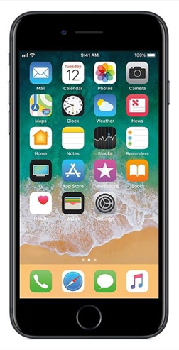

Phases of the study
Development of Acne Care Online
Phase 1a – qual. interviews with young people and parents/ carers
Phase 1b – qual. interviews with primary care prescribers and community pharmacists
Phase 2 – qualitative optimisation
Feasibility Trial
Recruiting from primary care and community, social media and schools
Participants randomised to Acne Care Online plus usual care OR usual care alone
12 week follow-up
Target n = 60
Effectiveness trial
Recruiting from primary care and community, social media and schools
Participants randomised to Acne Care Online plus usual care OR usual care alone
12 week (Primary outcome), 34, 36 and 52 week follow-up
Target n = 588

Slide 4



Background and aims
Acne is common and has significant impact on quality of life. Topical treatments are effective but adherence is low.
Acne Care Online is an online intervention with an embedded decision aid tool to aid help-seeking and support acne self-management.
The aim of this study is to optimise the intervention through an iterative process of gaining user feedback.

Slide 5



Recruitment and methods
Recruitment methods:
  Primary care mailout
  Social media
  Re-contacting earlier qualitative participants
Interviews:
  Held on Microsoft Teams
  Interviewer or participant shared their screen
  Audio recorded and transcribed
  Continued until no new feedback received
53 young people with acne interviewed. Purposive sampling by:
  Sex
  Age
  Ethnicity
  IMD
  Length of time with acne

Slide 6
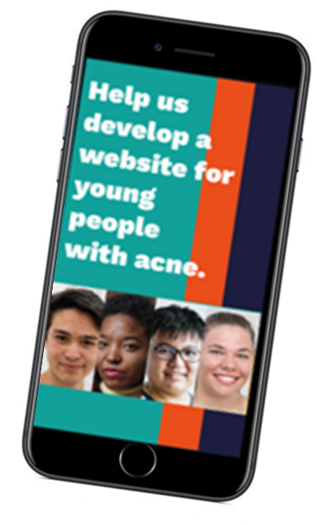
Sample characteristics
Participant characteristic | Frequency
Gender
Male | 15
Female | 37
Prefer not to say | 1
Age
13-15 | 16
16-18 | 17
19-21 | 9
22-25 | 11
Ethnicity
White/ White British | 33
Asian/Asian British | 14
Black/ Black British | 5
Not specified | 1
IMD
1-5 | 17
6-10 | 33
Not specified | 3
Recruitment strategy
Primary care | 27
Social media | 25
Length of time with acne
6 months to 1 year | 7
1 to 2 years | 10
Over 2 years | 36
Sample

Slide 7

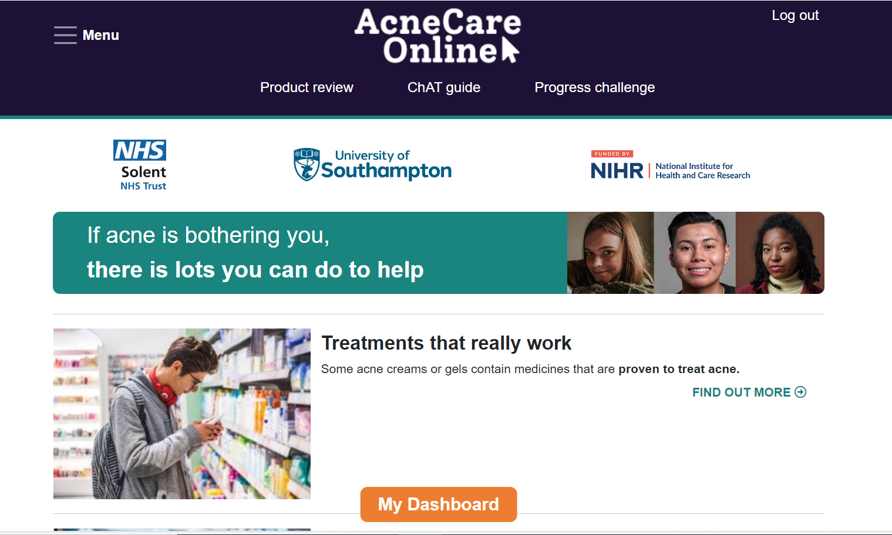
Intervention optimisation
Two types of interviews conducted:
Think-aloud interviews
Try out intervention in presence of researcher
Longitudinal interviews
Use intervention independently over 1 week
Have any behaviours begun to be adopted?
Collects very detailed data of user reactions
Understanding of how the intervention is used
Opportunity to explore key messages taken away

Slide 8
What did participants like?
Content, style and issues relatable
Credible and trusted resource with advice from HCPs
Valued the depth of information but accessible
Shared experiences from young people
Positive comments
"People like me have been involved, so they understand…”
“[The videos] were concise, which people love. People don't have time to be watching 20-minute videos.”
“[Ingredients list] is really useful as well because it's quite common to find so many products and you don't really know if the actual ingredients in them do anything to help or not”
“I think it's good to have a GP saying their advice because it's advice that people can trust.”

Slide 9

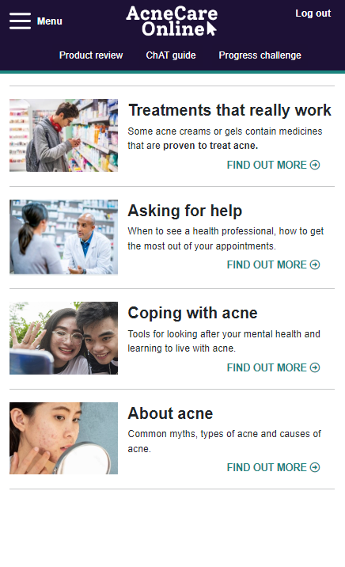
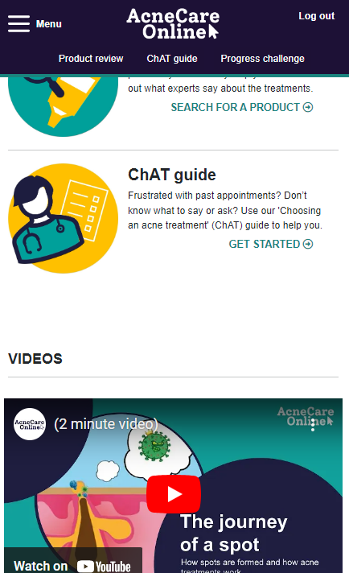
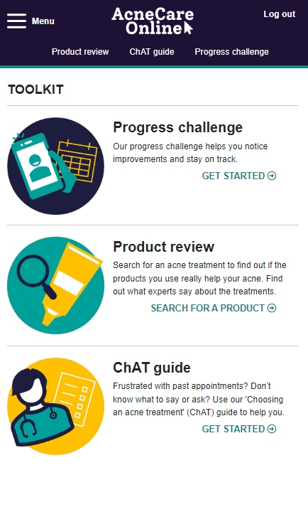
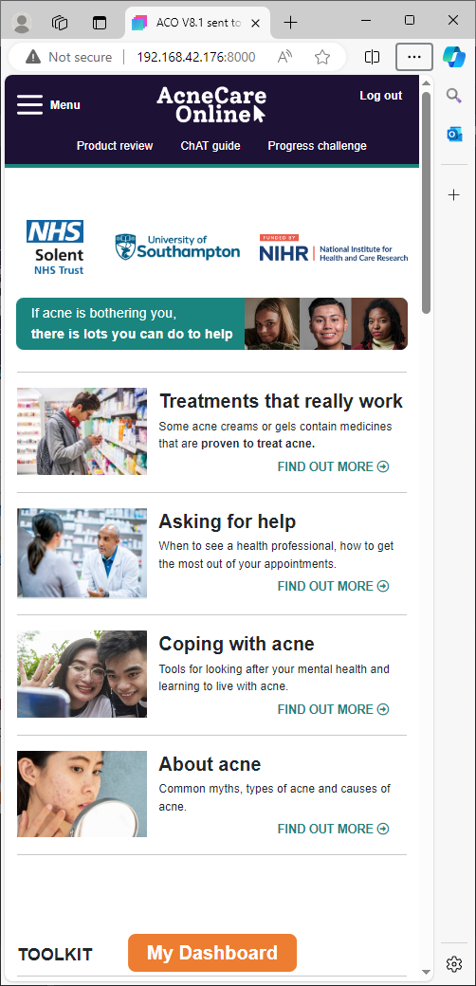
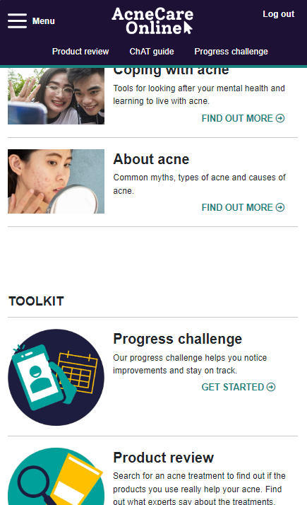
Example of change made: Navigation

Slide 10
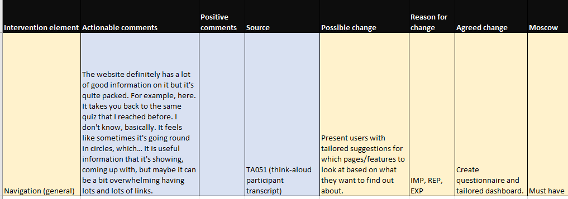
Table of changes: Navigation
“It feels like sometimes it's going round in circles…maybe it can be a bit overwhelming having lots and lots of links”
“I don’t mind scrolling but its probably more useful to see the headlines straightaway.”
The homepage is the thing you go on first…. The thing that you want is buried so deeply down. .”

Slide 11
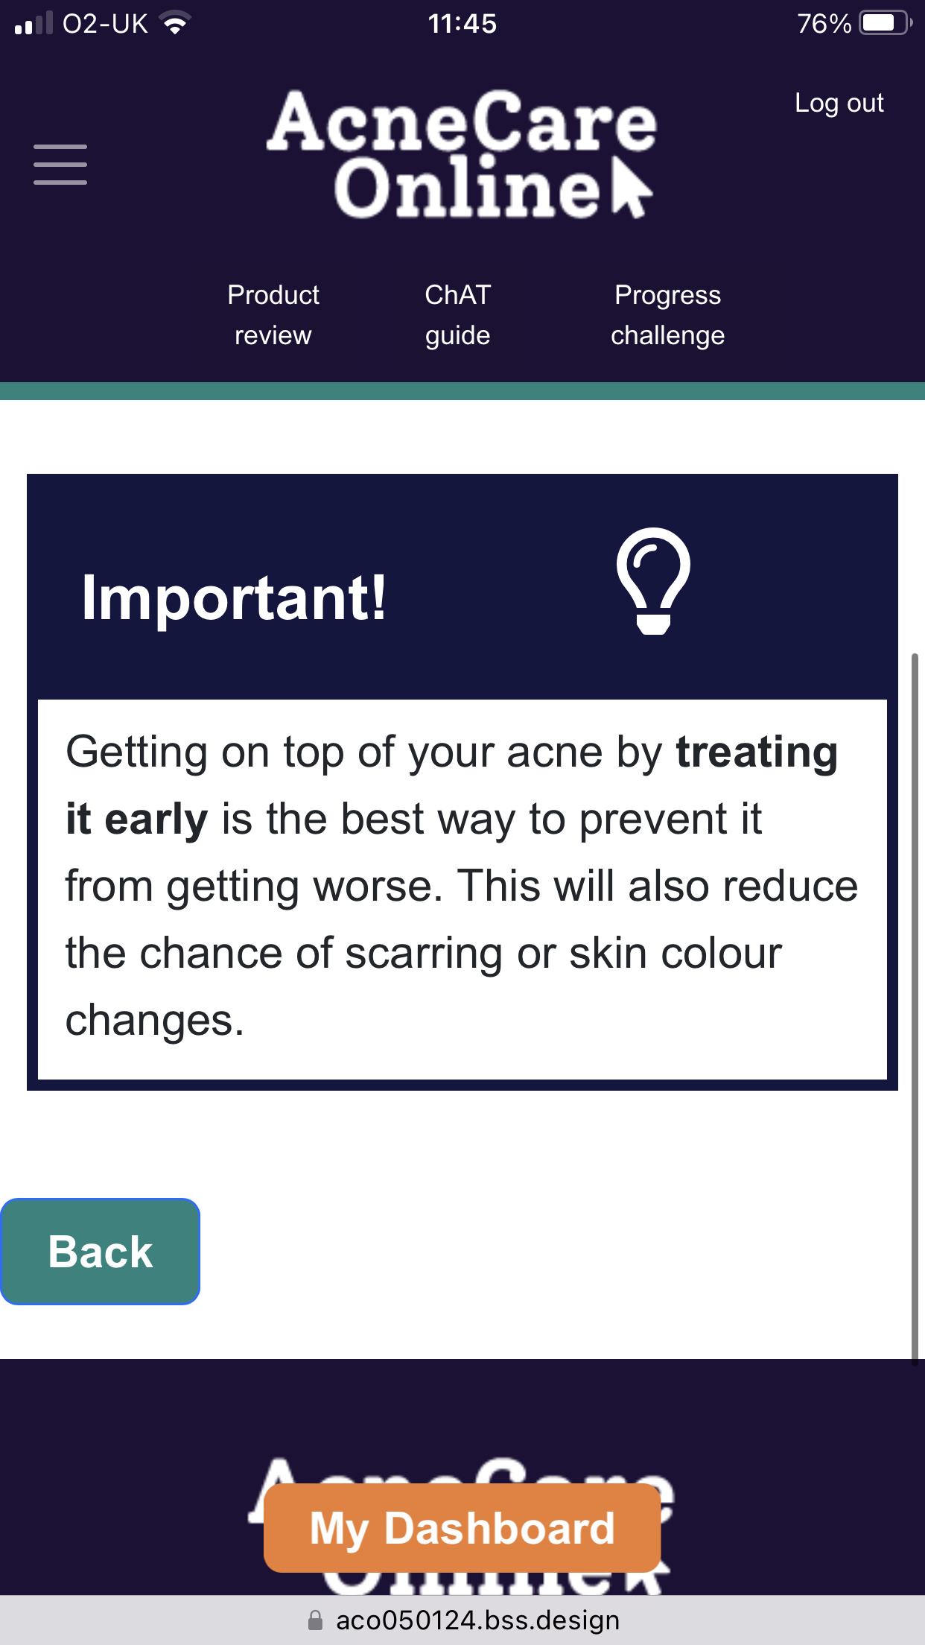

Navigation changes
  Toolkit and main menu available on every page
  Direction to key messages using ‘important’ boxes
  Personalised tailoring directing participants to relevant information

Slide 12
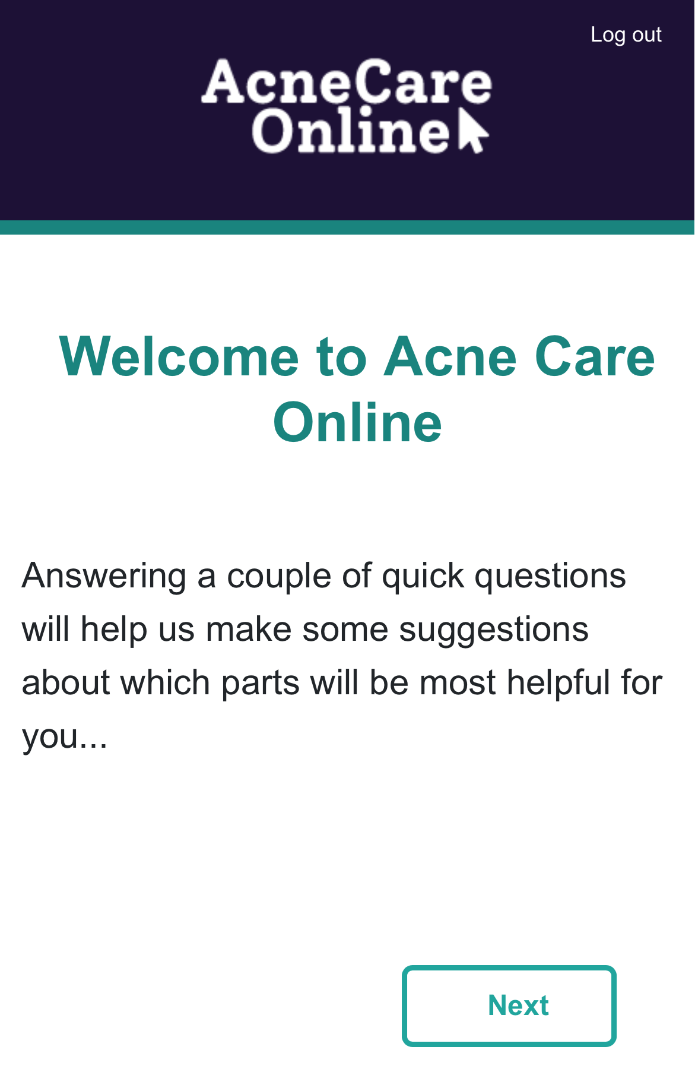
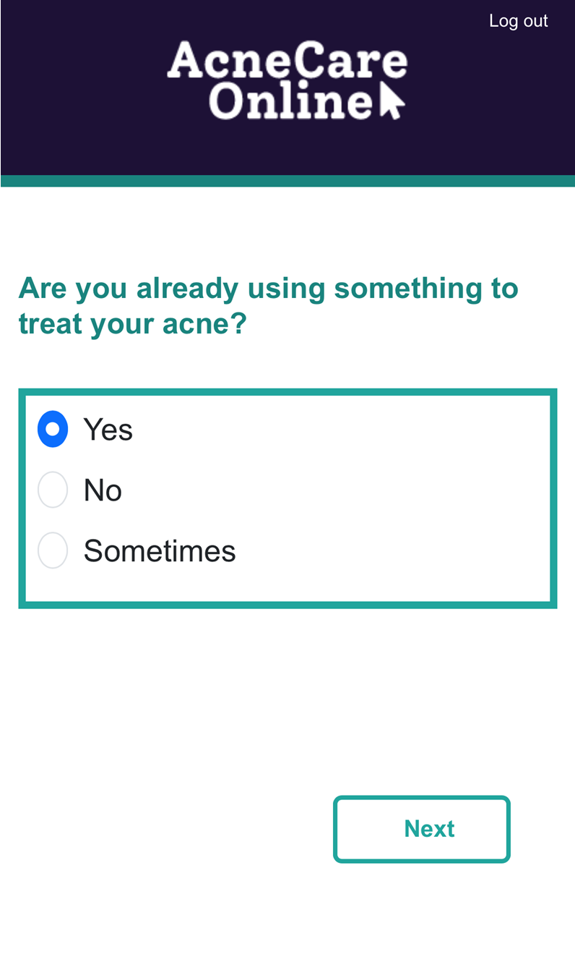
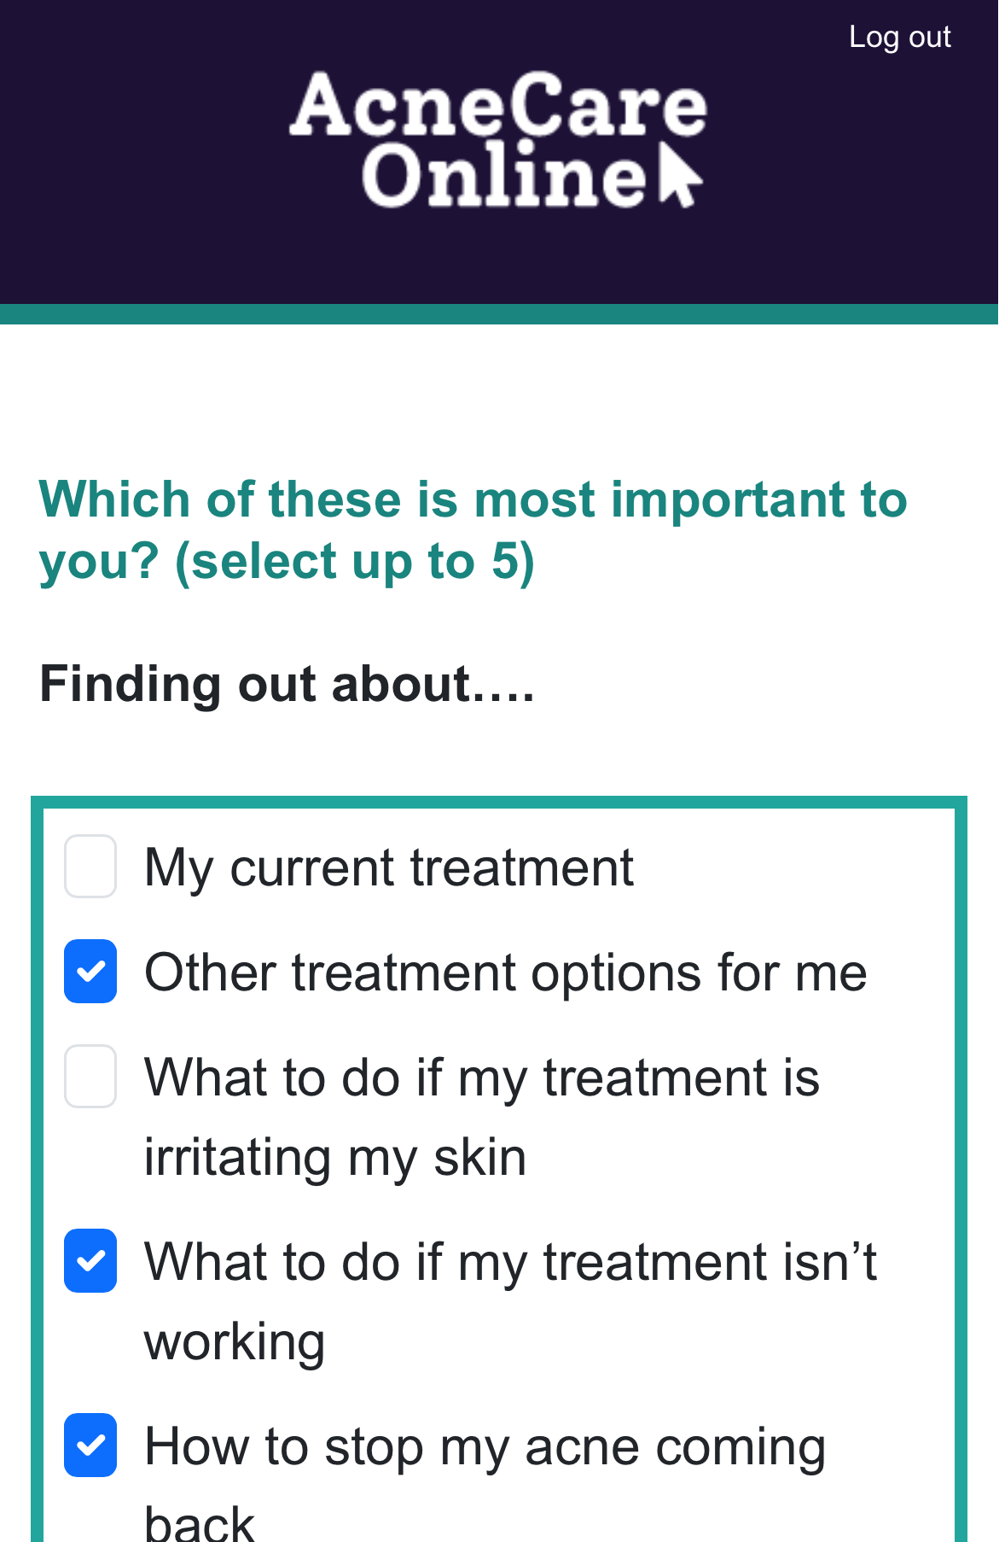
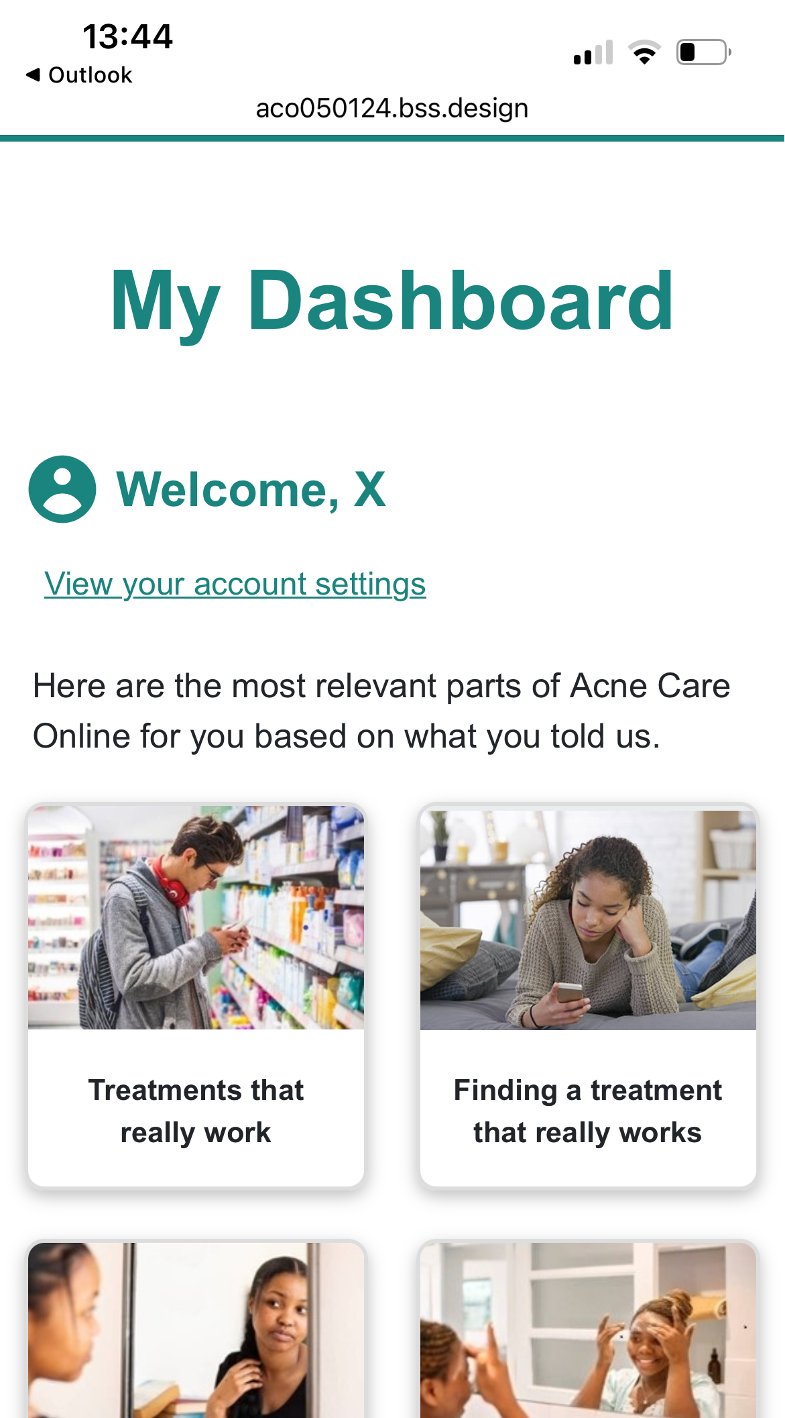
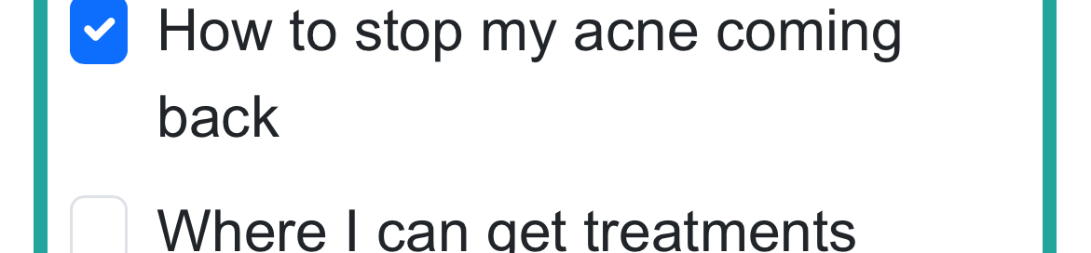
New tailoring and dashboard

Slide 13
What else did we learn?
Videos to be short and concise
Unclear of some key messaging
Misunderstanding key terminology e.g. topicals
Wanting further advice (e.g. maintenance treatment and scarring)
Actionable comments
“I didn't realise there were different types of topical treatments. I thought there were just all the ones you put on your skin”
“I think some of the speech was going a little slow, which can sometimes lose concentration, you know?”
“Maybe make more pop-ey boxes for key information…for me, if I saw that, unless it was highlighted in a bold font on keywords, I just would have browsed over that and brushed over it”

Slide 14
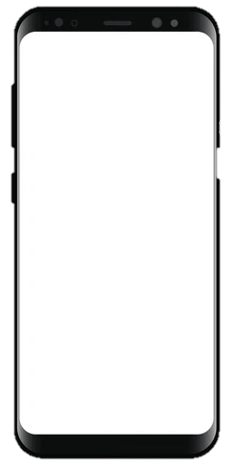
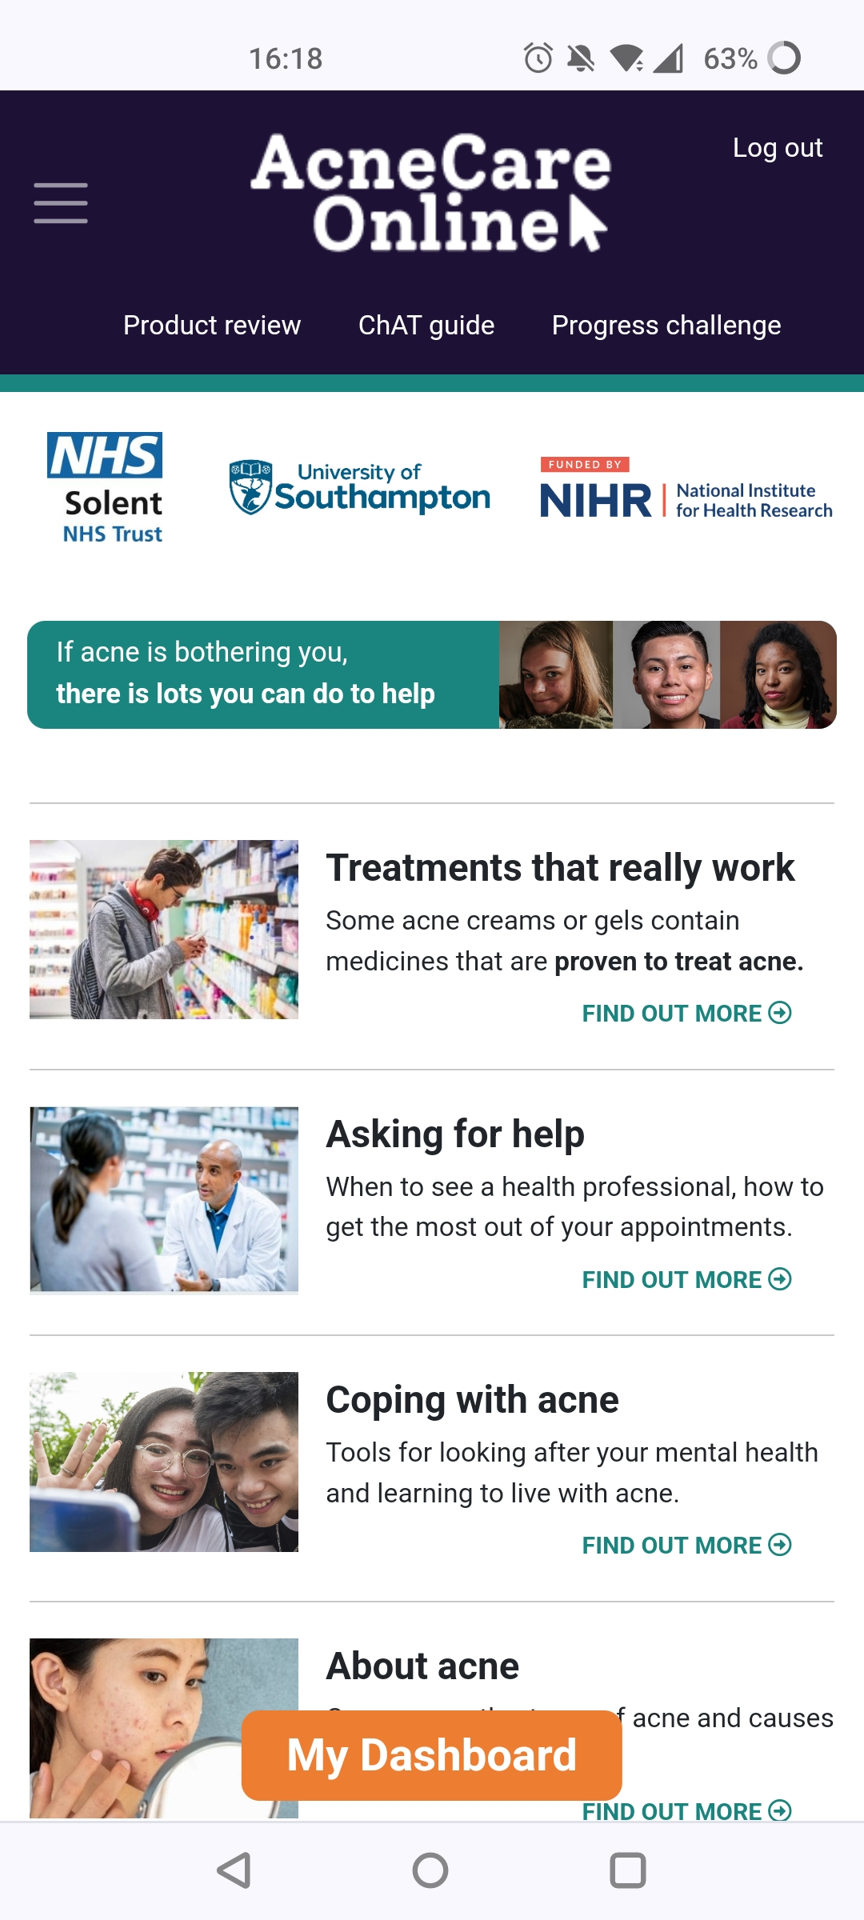
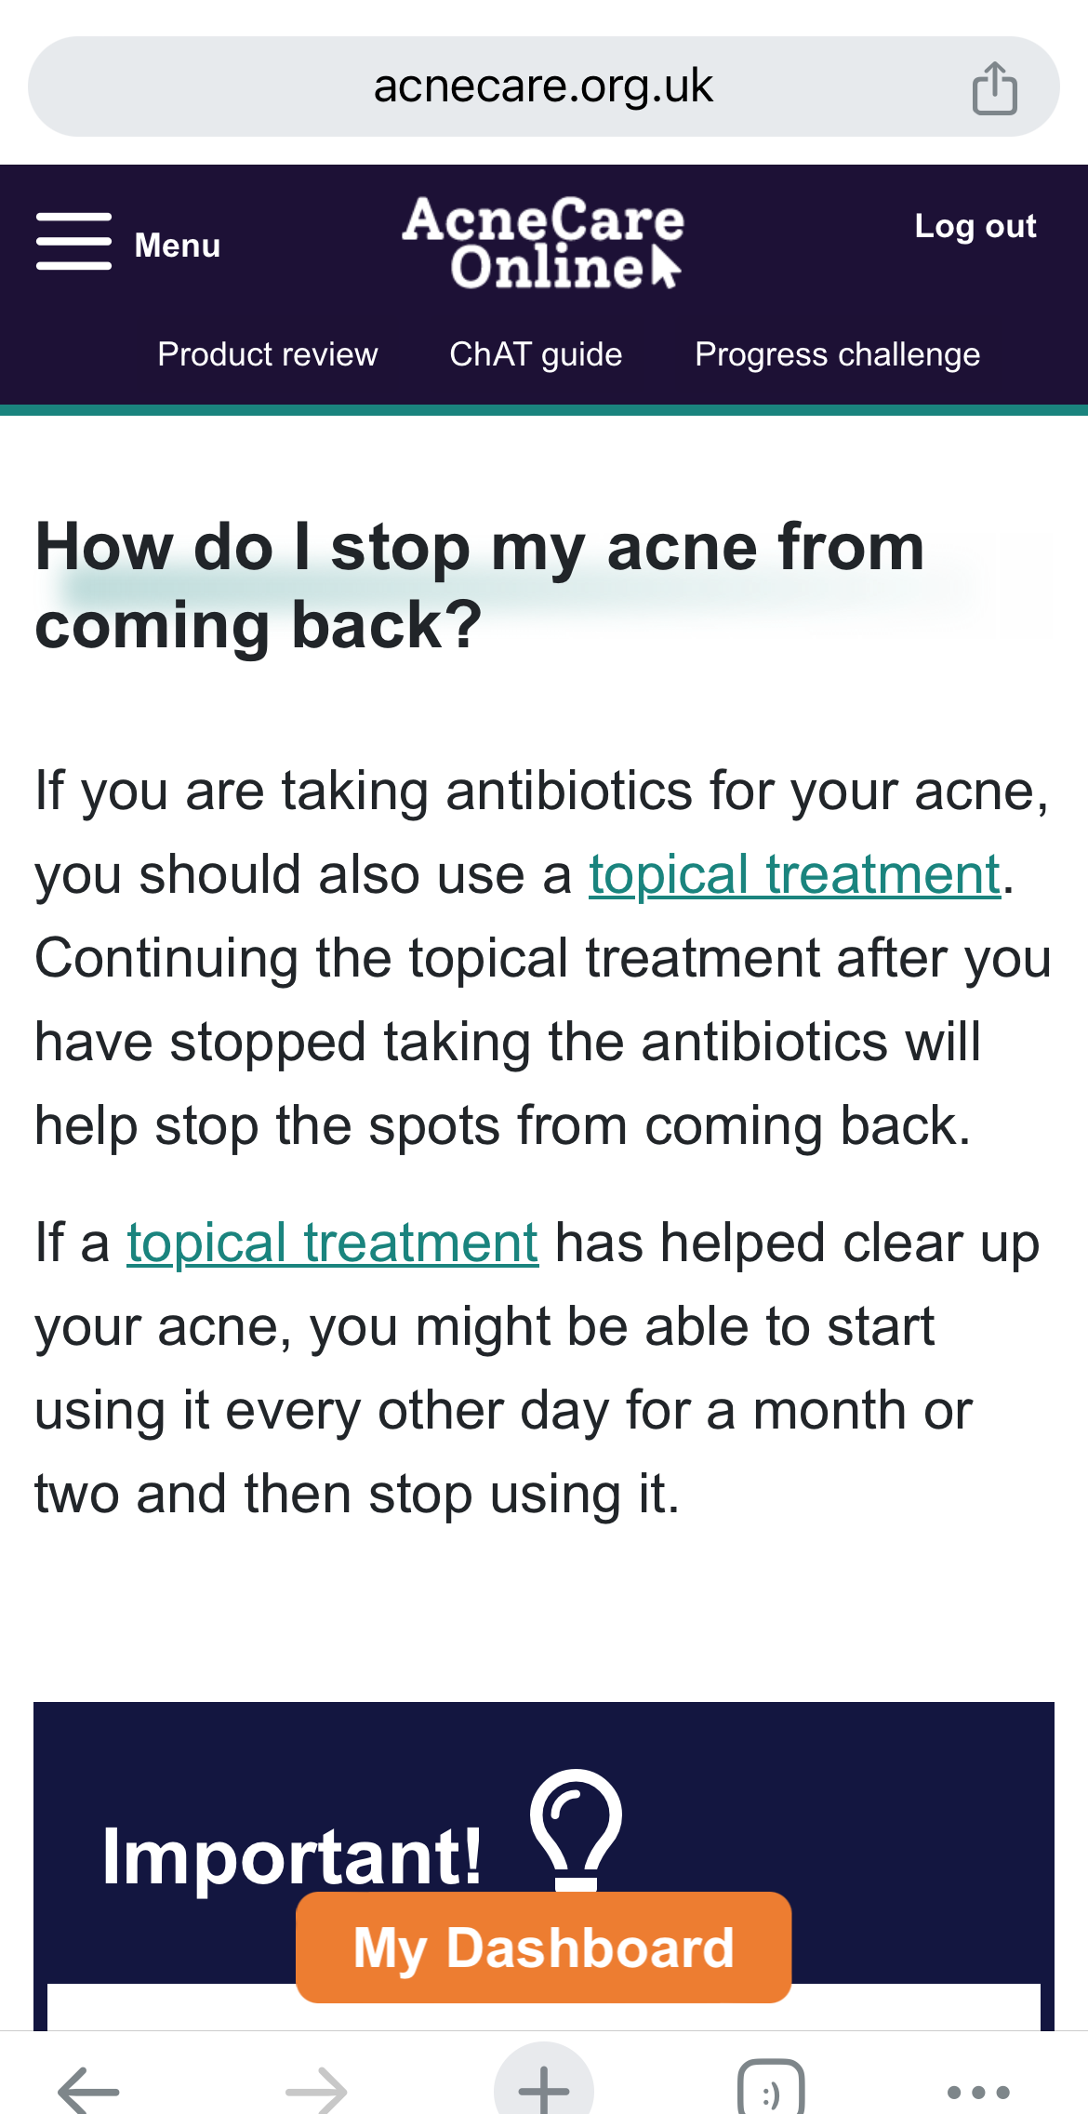
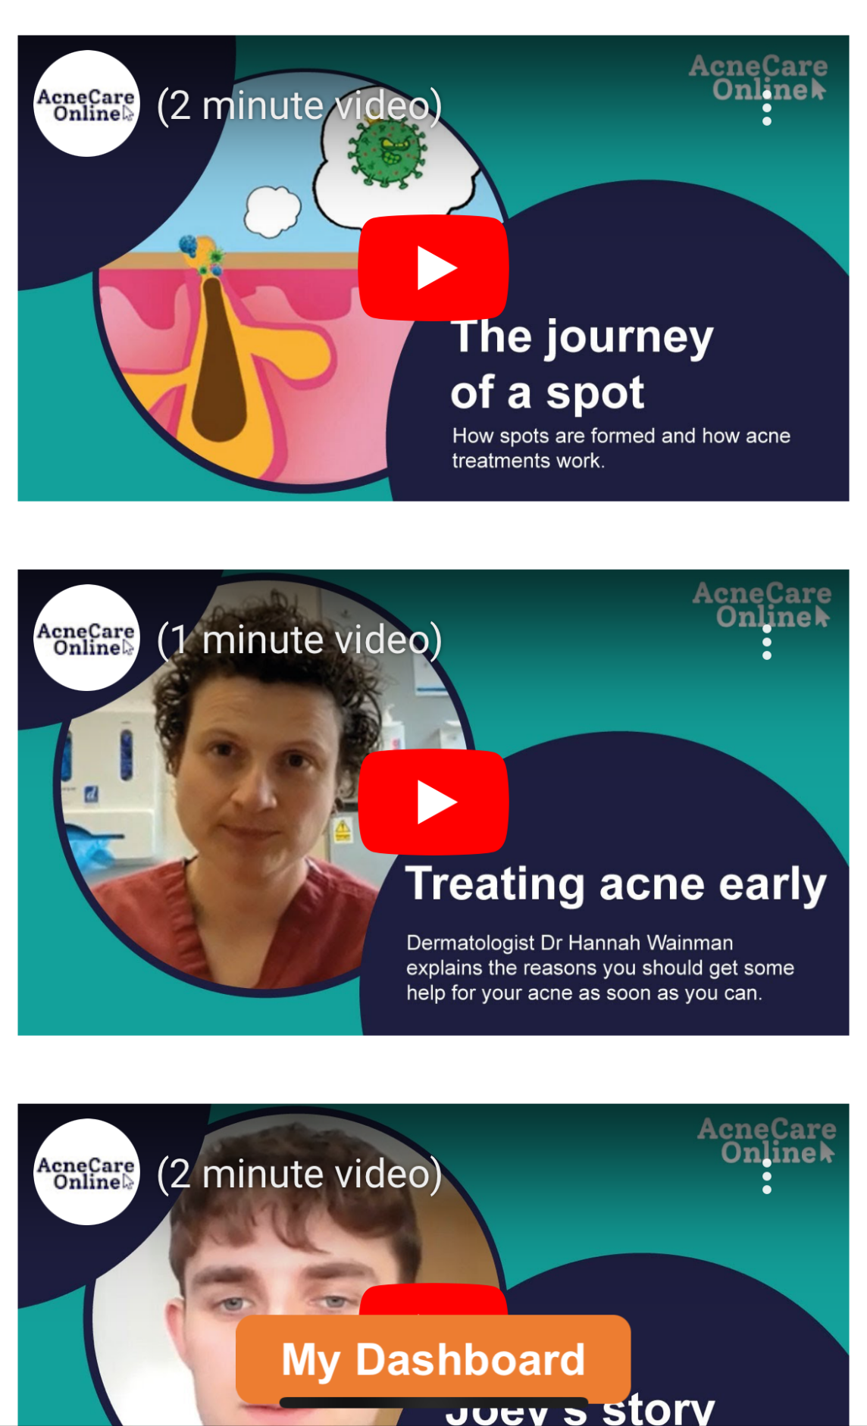
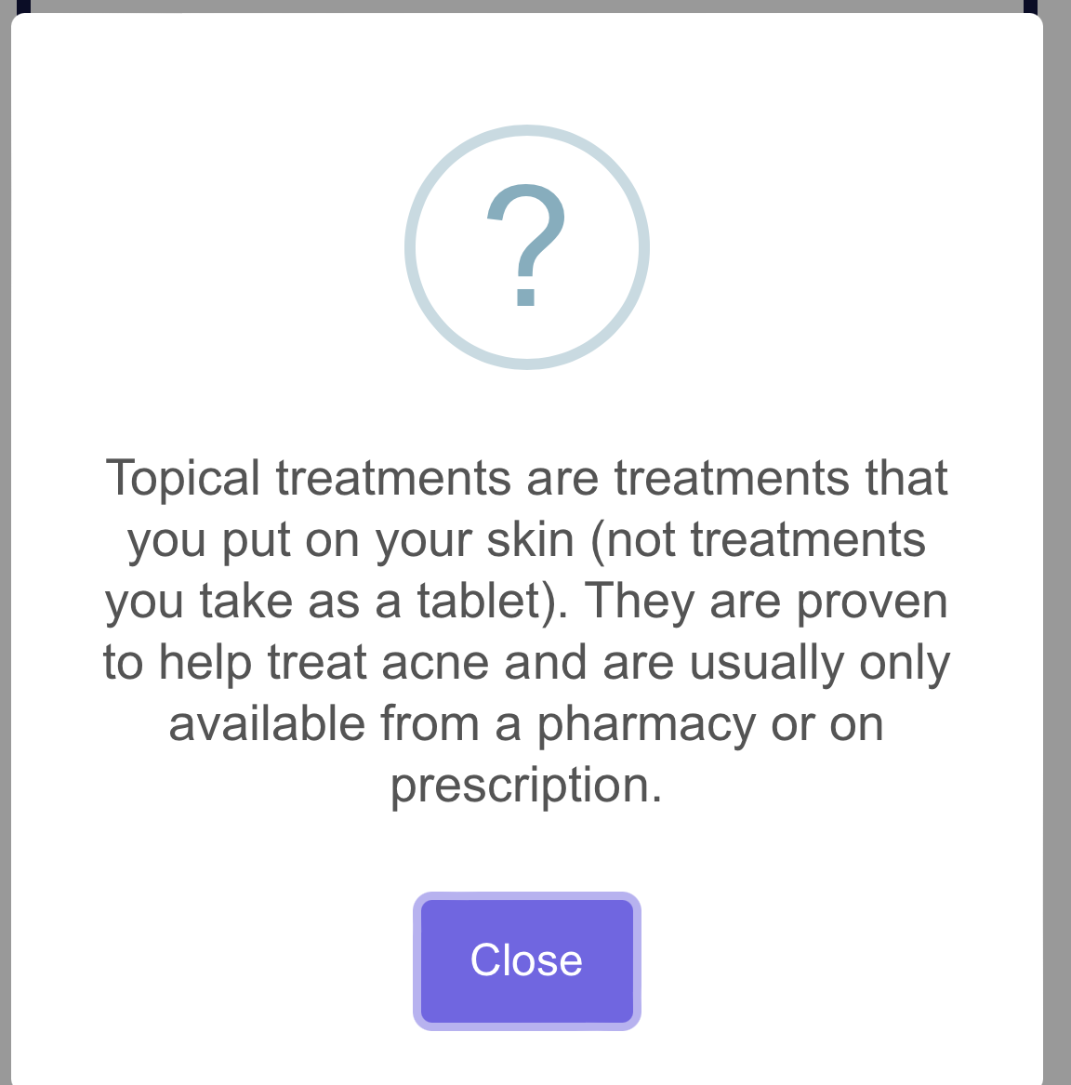
Changes made

Slide 15
Next steps
We have a final version of the website ready for trialling…
Nested process evaluation
Nested process evaluation
Feasibility trial
Pilot trial
Main trial
run into
Notes:
Nested process evaluations
Aims:
Explore barriers/facilitators to trial recruitment and retention
Inform programme theory for design of full-scale process evaluation

Slide 16
Questions/Discussion
acnecare@soton.ac.uk
@AcneCareOnline
This project is funded by the National Institute for Health and Care Research (NIHR) under its Programme Grants for Applied Research programme (grant ref No NIHR202852). The views expressed are those of the author(s) and not necessarily those of the NIHR or the Department of Health and Social Care.

